Slide 2

READING SCHOOL
Applications to Sixth Form
This PowerPoint will be shared via email
Sixth Form and Boarding Administrator

Slide 3
1. Why Reading School Sixth Form?
2. How do I get in?
3. Which subjects should I choose?
4. What about university and my career?
5. What is Sixth Form life really like?
6. Questions

Slide 4
1. Why Reading School Sixth Form?

Slide 5
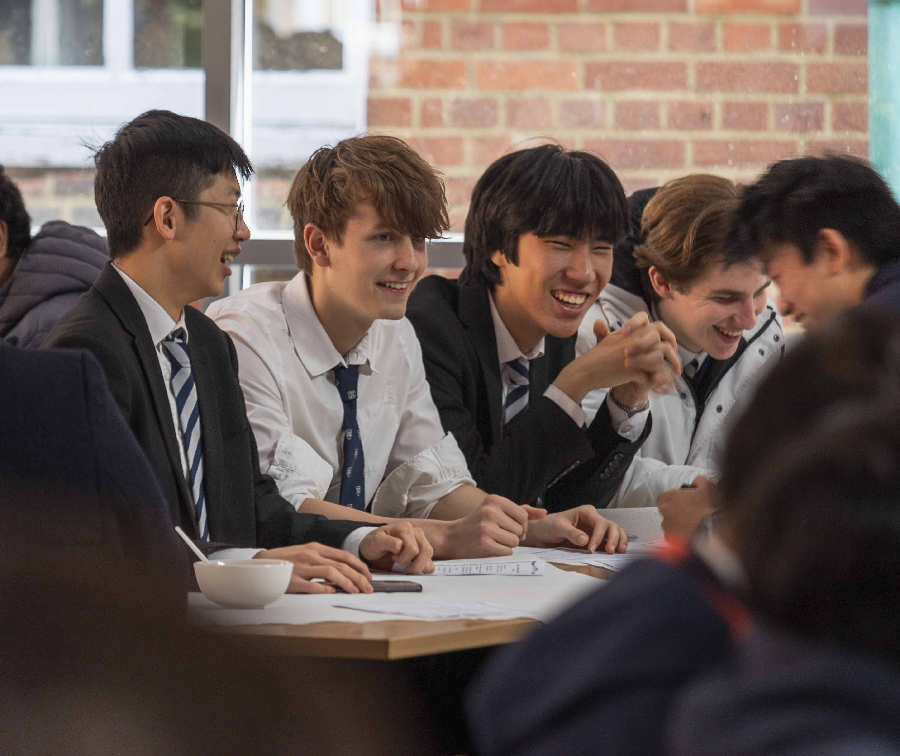

Slide 6
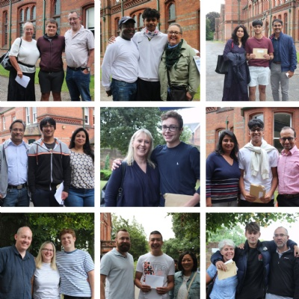

Slide 7
It’s all about the A, B, C.
A – Academic Excellence
B – Belonging
C - Character

Slide 8
2. How do students apply?

Slide 9
Entry requirements of 56 points or more from best 8 qualifications and a minimum of grade 5s in English and Maths. For Looked After Students/those in receipt of the Pupil Premium a minimum of 54 points from best 8.
Complete online form which went live on 1/12/25 and has a deadline of midday 30/1/26
Conditional offers will be made to those who have been predicted 56 points or more (applicants are ranked and offered place according to predicted grades), subject to availability in the A-levels selected by applicants.

Slide 10
PLEASE NOTE:
Students should consider subject entry requirements.
Those who live outside the designated area are unlikely to receive an offer for a day place so may wish to consider boarding.
Students may only select day or boarding on the online form, they cannot apply for both.
If anyone has any further boarding or admissions questions please see the admissions page or contact sixthformdmissions@reading-school.co.uk for admissions queries.

Slide 11
Application Priority:
There are three things to note about the priority given to applications.
1. 56 points is the baseline for potential offers, but in reality most offers will be done based on a highest overall predicted point score basis.
2. In high subscription subjects, highest predicted grades in those subjects will be a factor when making decisions, as will overall points score.
3. Selection of a lower subscription subject will give students a better chance of getting a place.

Slide 12
What if they’re predicted sub-56 points?
Simply put, they will not be given a conditional offer at this point.
However, if they go on to achieve 56 points in the summer exams, we will be able to consider them for a place, however, we are likely to be over-subscribed. We may have spaces for a small number of students, so do please email the school on results day.

Slide 13
Applicaa
- When applying, we use the Applicaa system. A link to the form can be accessed via the school website.

Slide 14
3. Which subjects should they choose?

Slide 15

Moment of change

Slide 16
Which subjects are available?
Art (options - Fine, History and Photography)
Biology
Chemistry
Classical Civilisation
Computer Science
Economics
English Literature
French
Geography
German
History
Latin
Mandarin
Maths
Further Maths
Music
Philosophy
Physical Education
Physics
Politics
Spanish
Theatre Studies

Slide 17
1. Which subjects do they think they need for next steps to university or a future career?
2. If their university or career path did not require particular subjects, which three subjects would they select based solely on their passion or interest?
3. What's the right balance between pragmatic choices which facilitate next steps, and personal preference which fulfils intellectual need and nurtures curiosity?
Three things to consider:

Slide 18
How many A-levels should they study?

Slide 19
1. Select the number of choices that give them optimum chance of three top grades.
2. Select four subjects only if this will not disadvantage their top three grades and a fourth genuinely helps to distinguish them from other candidates when applying to the most competitive universities and courses.
3. Select the right courses from the start: ‘dropping a subject’ part way through the course disadvantages their progress, and restricts opportunities for others.

Slide 20
Last Year:
56% gained 3 A-levels
43% gained 4 A-levels
1% gained 5 A-levels

Slide 21
Key Information
Each subject has its own entry criteria. Students need to know these before applying and they need to achieve these in order to get a place on the course.
56 pts for three A-levels.
64 pts for four A-levels.
We create the blocks after applicants have indicated their preference, so we can give the most students possible their first choices. Doing it this way does mean a small number of students will have to pick alternatives after the blocks are made.

Slide 22
Key Information –
Further Maths
One of our most desired courses, but also our singularly most difficult course. You have to study four A levels as well to be enrolled for the course in Yr 12.
64 points or more needed from your best 8 GCSEs and need a 9 in Maths to opt for it.
FM is only good if you will do well in it. It is the only subject we run that we assess suitability for during the year.
Students have a number of assessments in Year 12, the result of which will indicate students who will not be able to access the course and who will be encouraged to drop.
If, after further assessment the student continues to fall short of the required standard, we will remove the student from the course.
It is always done with the best interest of the student in mind.

Slide 23
Key Information –
Further Maths
It can be important if you want to attend a Top 5 university and study Maths, Computer Science, Economics or Engineering BUT lots of very good universities/options without it. Last year successful Oxford Engineering applicant who did not have FM.

Slide 24
Physics and Economics
Every year we have a glut of people who do Economics and Physics as two of their A-levels
This is nearly always a bad combination, because it screams of someone who hasn’t decided whether to be an engineer or to go into finance.
Now is the time to choose this, because spending 18 months doing both and then making that choice is a waste of time.
We will have individual conversations with anyone who selects both and be likely to discourage them unless they have a compelling reason to do both

Slide 25
4. What about university and my career?
Mr Whitehorn dwhitehorn@reading-school.co.uk
see the Beyond Reading School video on school website.

Slide 26
University Destinations
We have a great record of students from Reading School going to excellent universities.
Last year, 21 boys went to Oxbridge and we had a large number attending other prestigious universities.
I’ll say it now, but will no doubt repeat it over the coming years. Attending Reading School is not a rubber stamp for getting into Oxbridge. It requires a great deal of effort and it really is not for everybody. We will support your son’s application wherever they wish to go and listen to their preferences. Oxbridge is not the be all and end all.

Slide 27
University Destinations
Approximately 60% (108 students) of the cohort this year sat University Admissions tests for the most competitive university courses.
Typically, we expect around 25% of each cohort to achieve entry to the UK’s most competitive courses – with an average of 22 Oxbridge entrants and 27 students successful in their Medicine, Dentistry or Veterinary Medicine applications.

Slide 28
University Courses
Maths leads the way, with Economics, Medicine and Engineering close behind.
All that matters though is what they want to do. We will always do what we can to make sure we can support and facilitate them on their journey.
The UCAS support students get at Reading School is second to none.

Slide 29
Apprenticeships
Opportunities we will be actively sharing with students.
Increasingly popular.
We have had students go to apprenticeships with:
  The Bank of England
  Goldman Sachs
  JP Morgan
  Don’t think of university as the only option, post-school, apprenticeships are impressive, competitive and valuable alternatives. Many are also degree apprenticeships, so they provide the best of both worlds.

Slide 30
5. What is Sixth Form life really like?

Slide 31
Priorities in Reading School Sixth Form
Safety Happiness Success

Slide 32
Pastoral Structure
Every student is part of a form of around 18 pupils.
All students are also part of one of five houses.
Their form tutor is the first point of contact for you and your child.
The Sixth Form Team will also support where necessary.

Slide 33
The Sixth Form Team
Sixth Form and Boarding Administrator
Sixth Form and Boarding Administrator
Your child’s form tutor:
Mr McGall – Assistant Head Pastoral
Mr Whitehorn – Sixth Form Transition Lead
Mrs Majorossy – Sixth Form Intervention Lead
Miss Stratford – Sixth Form Pastoral Lead
Mrs Alberici - Sixth Form and Boarding Administrator
Head of Houses remain linked to Sixth Form

Slide 34
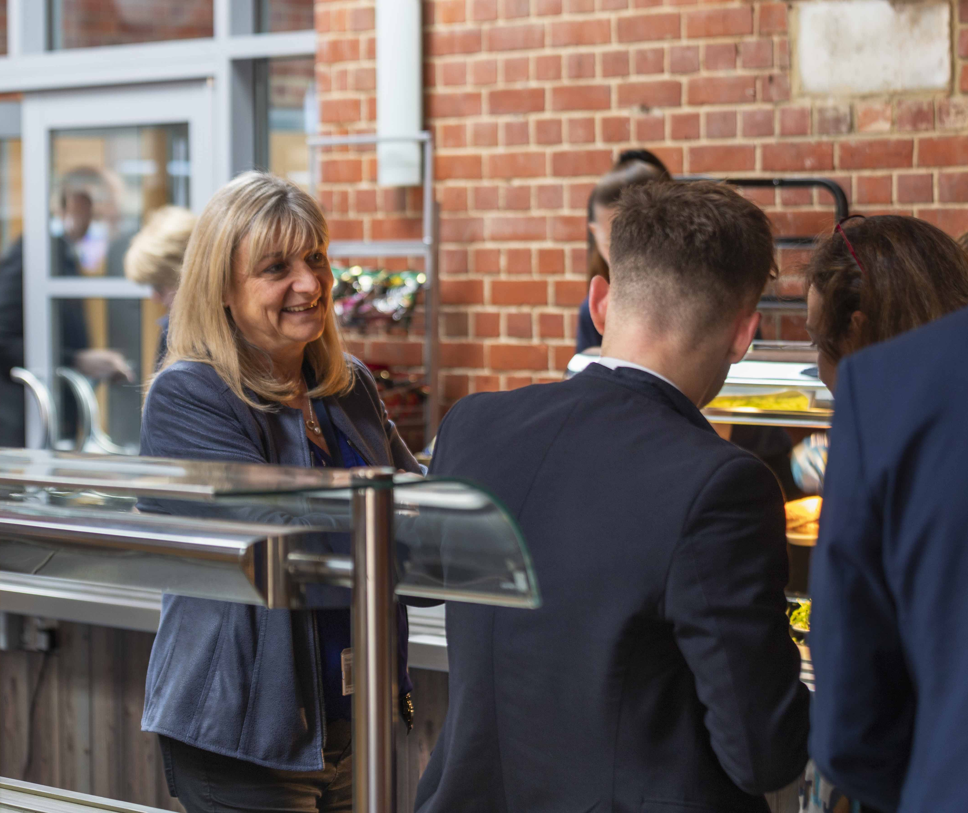
Holistic approach. Educating the mind, but also the character.

Slide 35

Collaborative and independent learning environment. Supplementing traditional classroom teaching with digital learning

Slide 36
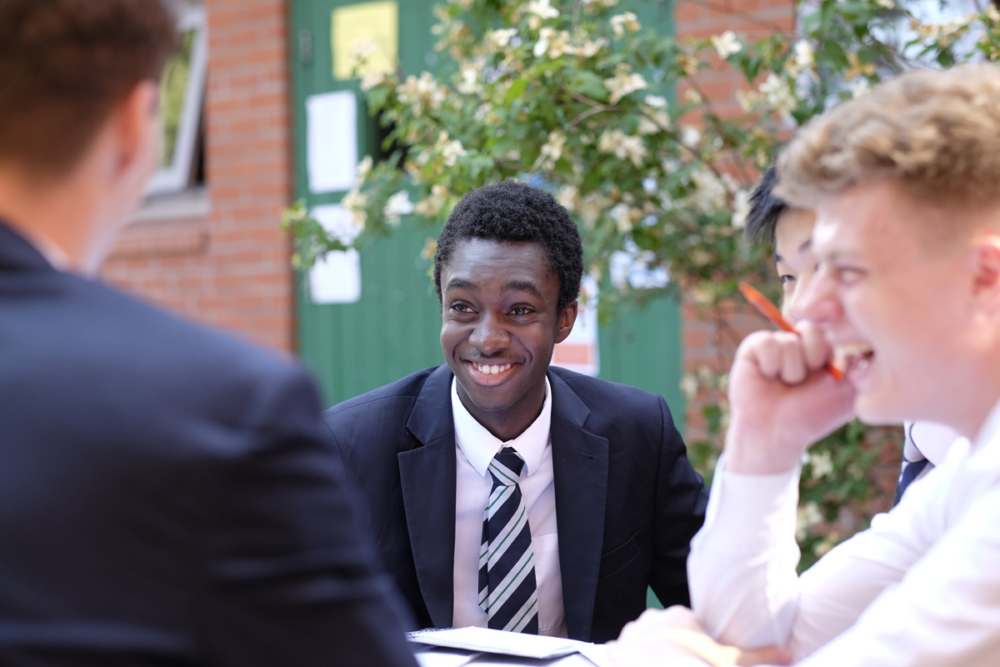
Academically pacy and rigorous

Slide 37

High expectations of all students (uniform, behaviour, work ethic, service)

Slide 38
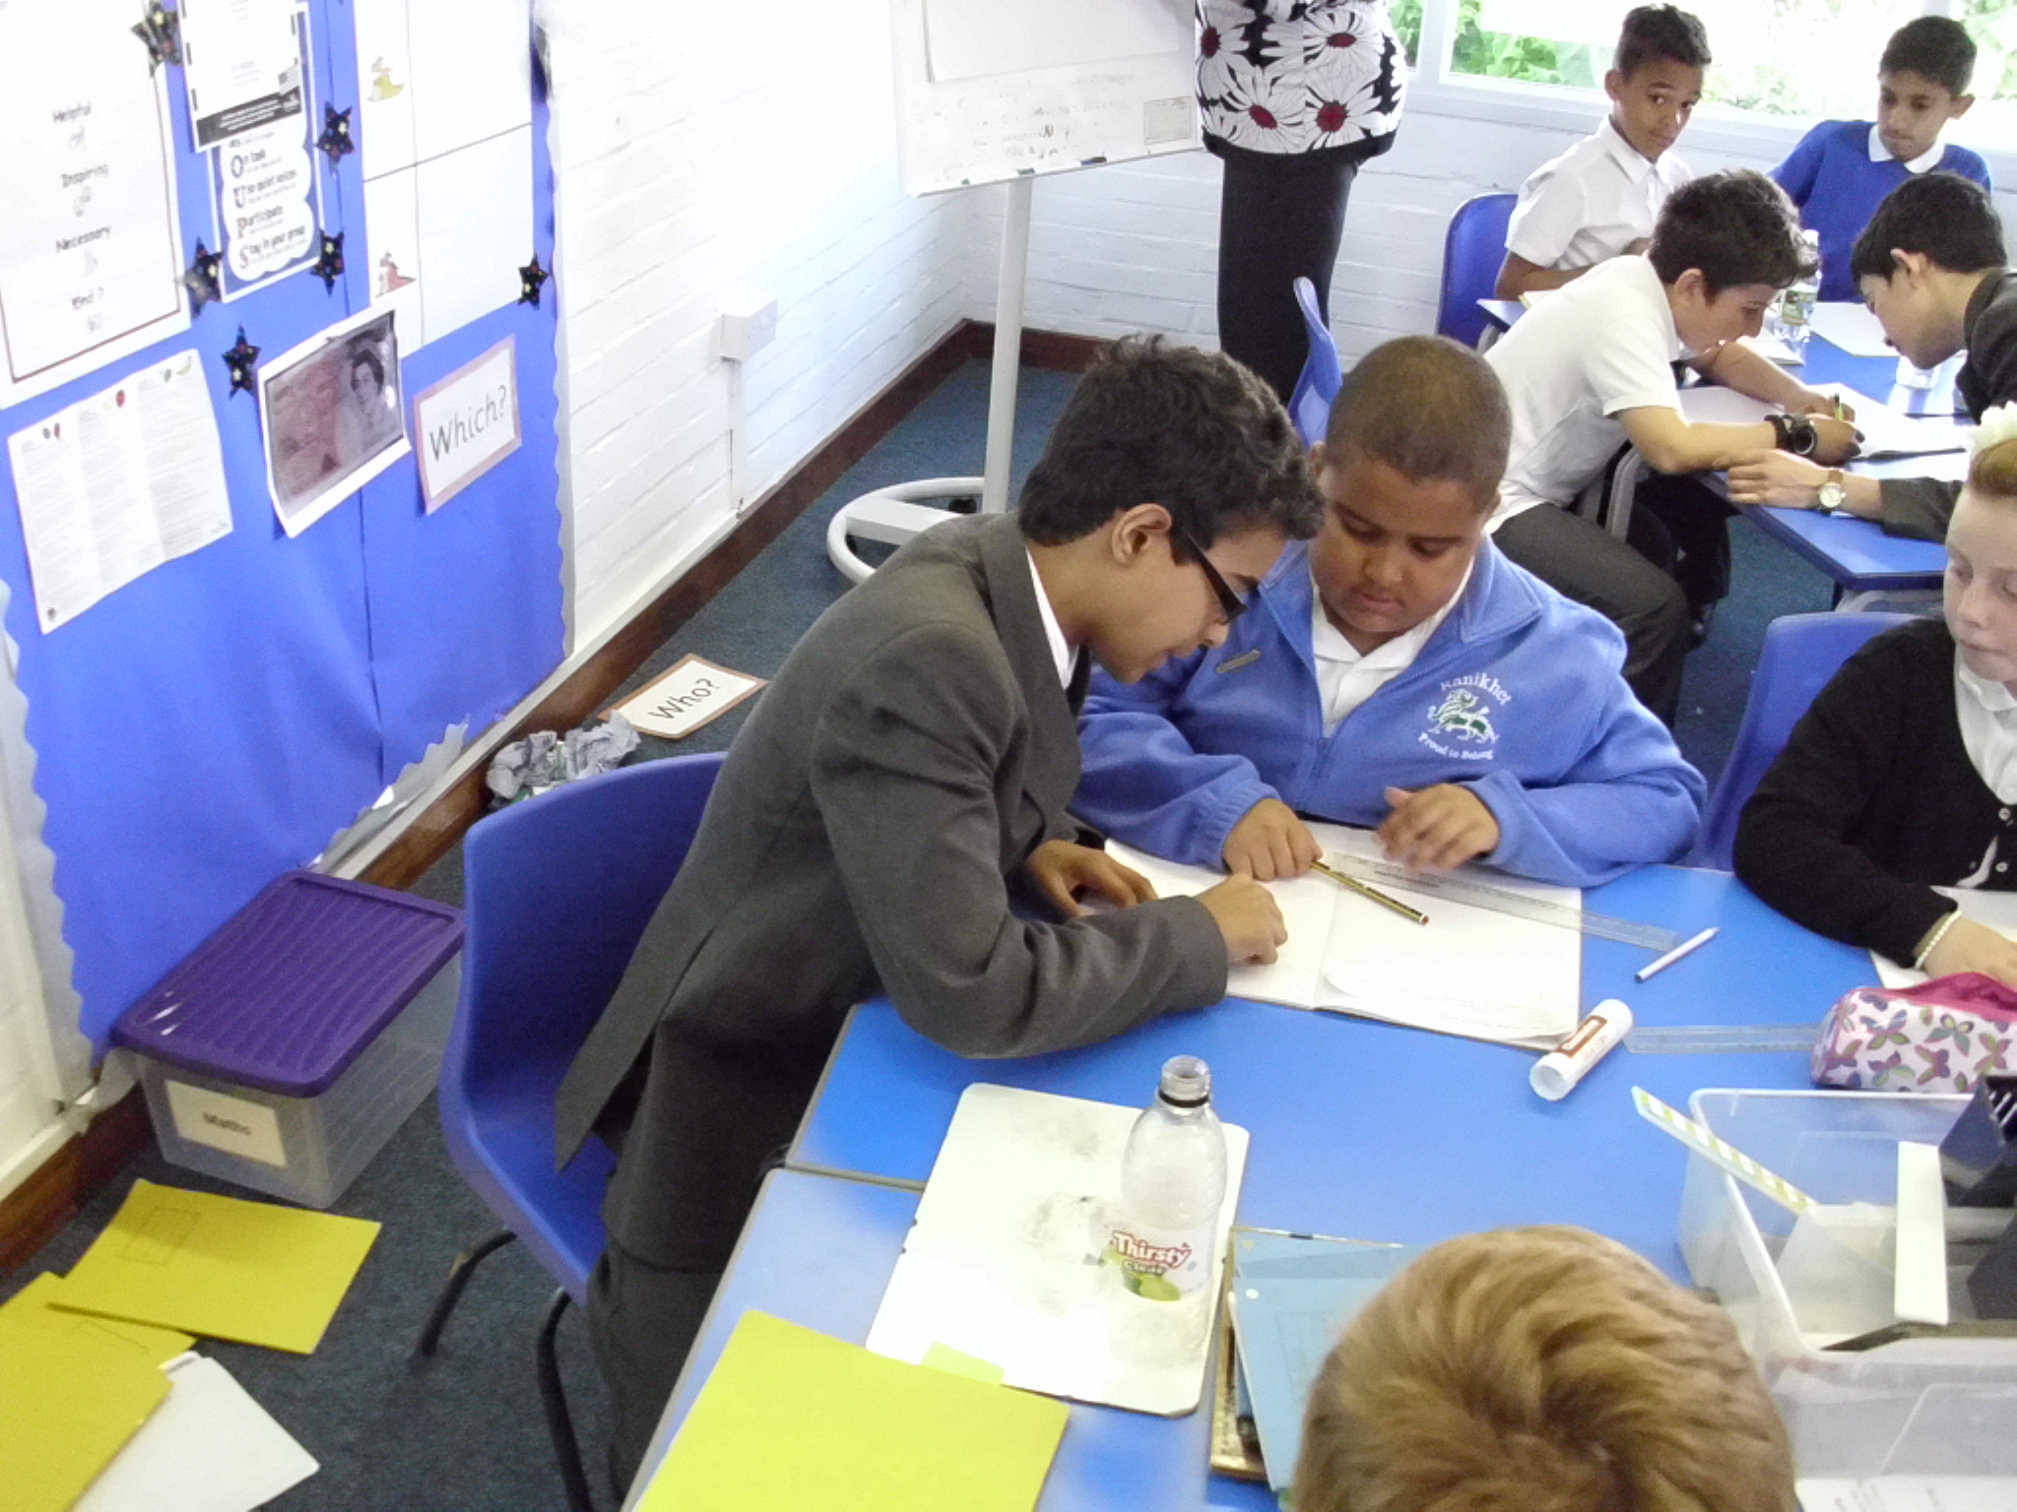
Service – every student expected to give back to the School and community. Our students are more than grades on a piece of paper.

Slide 39
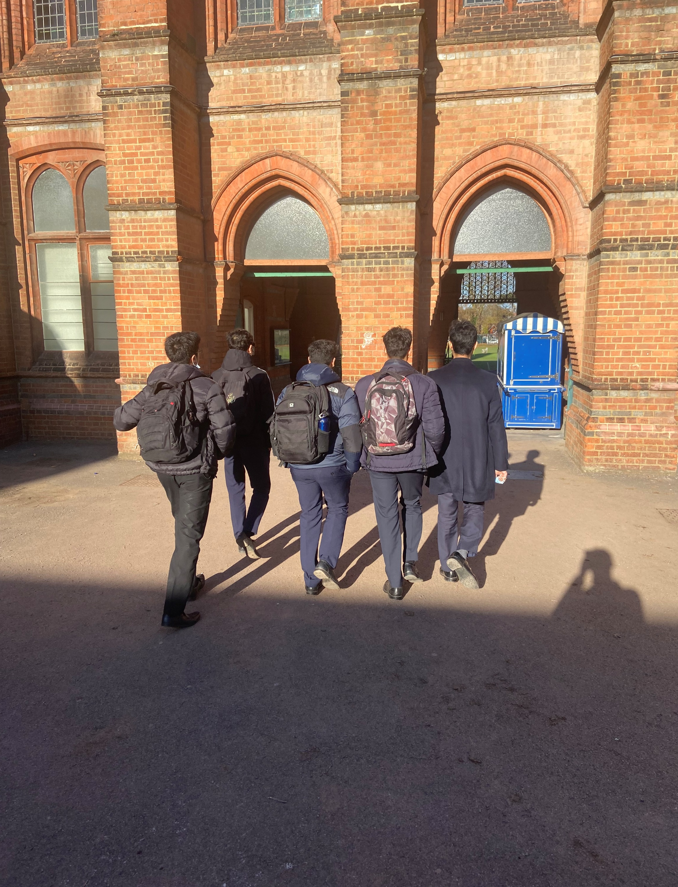
Independence: students arrive for their first lesson of the day and leave after their last. Not tied to the school site from 8:20-3:35. Encourage independent study and embracing a breadth of opportunities.

Slide 40
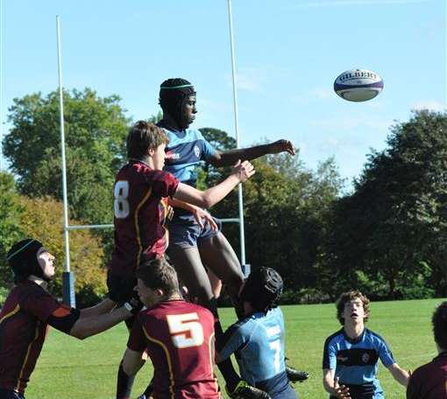

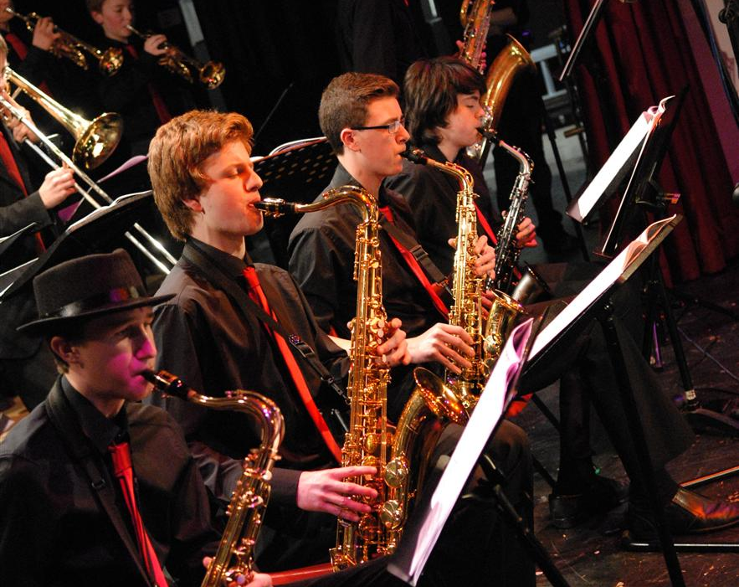
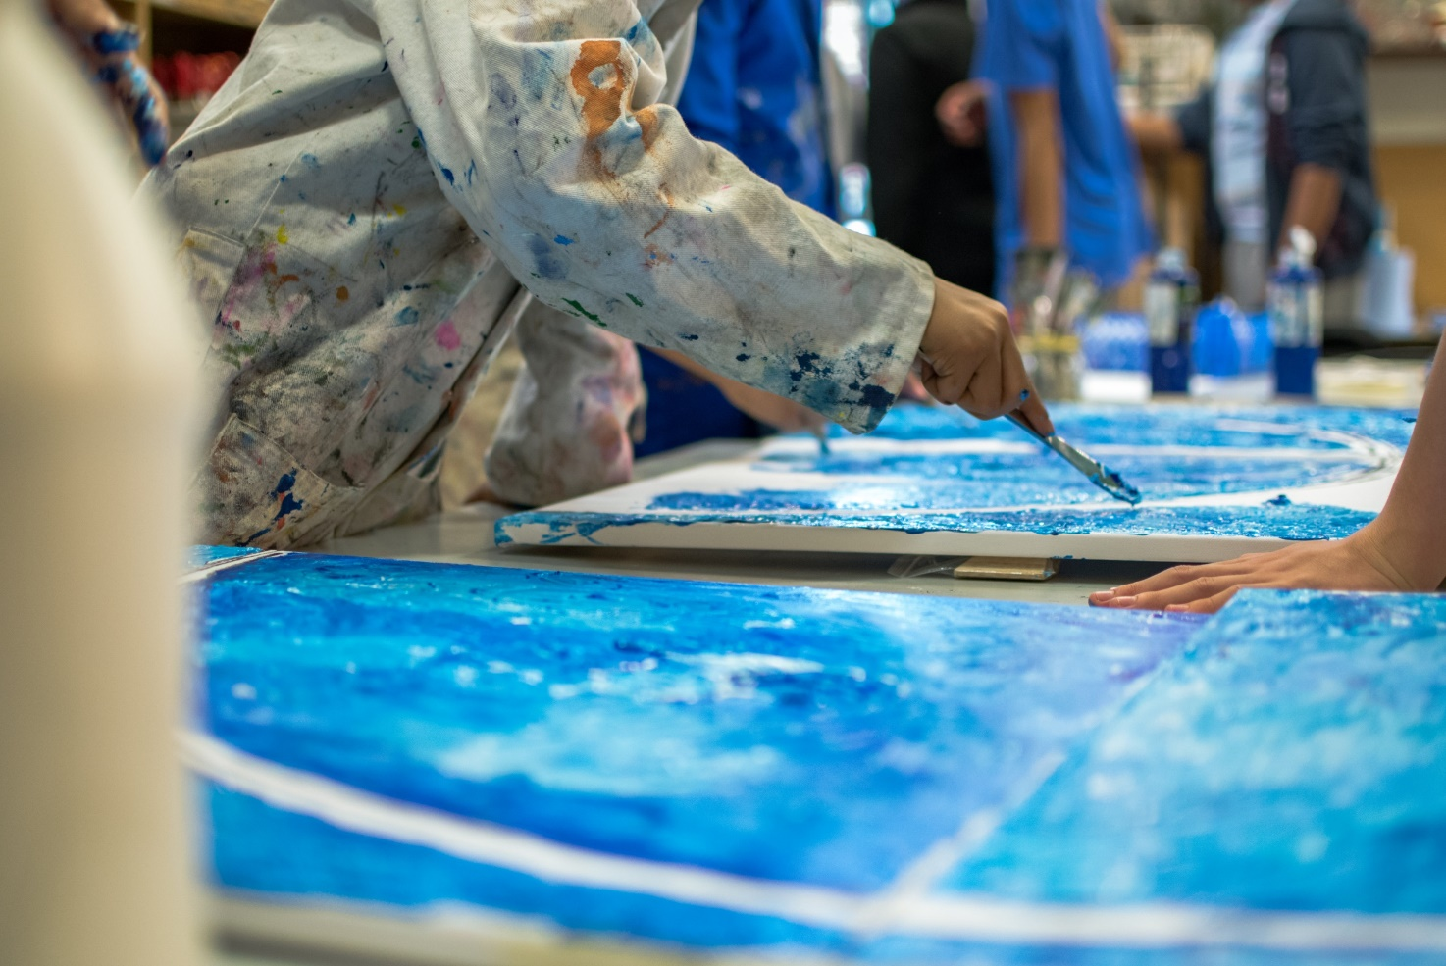
Full of opportunities, whether that be creative, leadership, musical, sporting or anything else that students wish to lead on

Slide 41

Nurturing and safe. Our priorities are safety and well-being first, happiness second and academic outcomes follow on from the first two being right.

Slide 42
Thank you for listening
Admissions Questions?
Mrs Alberici - sixthformadmissions@reading-school.co.uk
Boarding Questions?
Speak to Mr Lloyd (alloyd@reading-school.co.uk)
Careers Questions?
Speak to Mrs Ayres (layres@reading-school.co.uk)

Slide 43
Any Questions?

