Slide 1
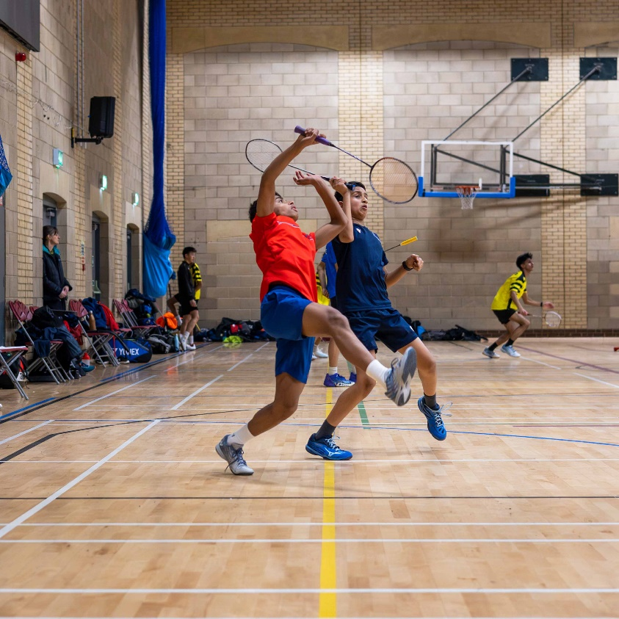
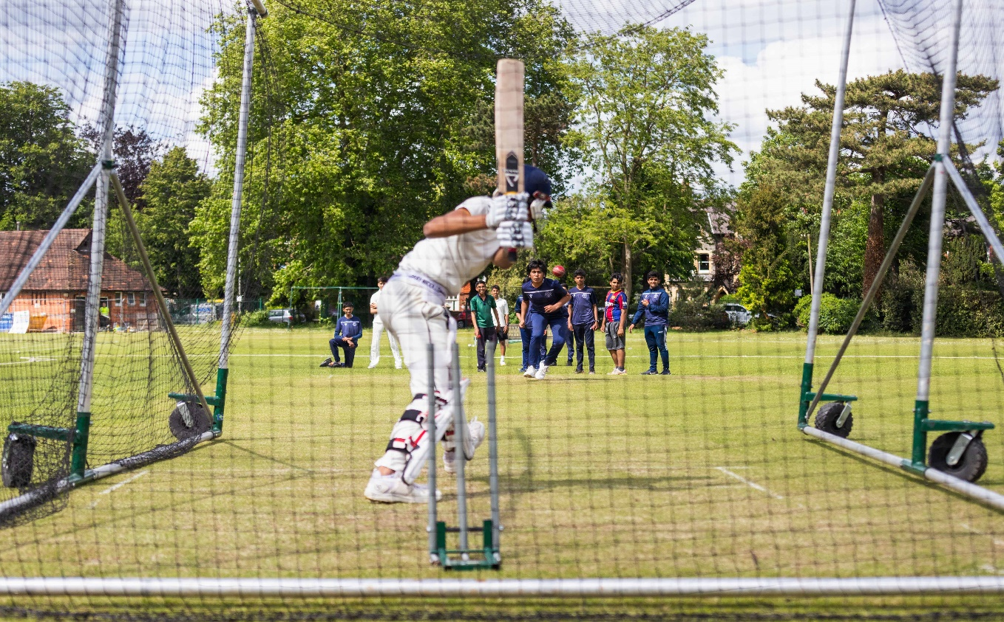


Spring Term 2026
Co-curricular activities

Slide 2
Music Ensembles and Choirs​
​ | Monday​ | Tuesday​ ​ | Wednesday​ | Thursday​ | Friday
JUNIOR LUNCH ​ ​ 12-12:45​ ​ ​ ​ |  |  | ​ | Junior Choir Y7-10​ Mr Newman Music School​ Open to all boys, all abilities​ ​
SENIOR LUNCH​ ​ 13:00-13:45​ ​ ​ ​ | ​ | ​ | Senior Choir Y11-13​ Mr Griffin Music School​ ​ | ​ ​
FORM TIME 12:45 |  | Intermediate Guitar Ensemble​ Mr Sibley​ Recital Hall​ ​(G3+)​ |  |  | Advanced Guitar Ensemble Mr Sibley (Audition only)
AFTER SCHOOL​ ​ 1530 - 1630​ ​ ​ ​ ​ | Reading School Orchestra​ Mr Griffin​ Music School​ ​ Open to all string, brass, woodwind & percussionists​ Appropriate for ability Grade 3+​ ​ | Chapel Choir​ Mr Druce ​ Chapel​ A small advanced vocal ensemble for boys Y7-13. ​ Entry by audition ​ ​ | Jazz Band​ Mr Newman​/Mr Griffin Music School​ High Level Big Band​ Brass, piano, guitar, bass and drummers. ​ Entry by audition

Slide 3
PE clubs and squads
​ | Monday​ | Tuesday​ ​ | Wednesday​ | Thursday​ | Friday​
​ After school clubs take place from 3.30 – 4.30 ​unless otherwise detailed. ​ ​ ​ ​ | ​ Badminton All Years 4 - 5 pm At Reading University Mr Pedlow ​Community Rowing​ Year 12 and 13 rowers Mr Stevenson 3.30-5.00 pm @ the boathouse Frisbee All Years Mr Whitehorn School Field Starting end of January 2026) | Football Training Year 8 Reading Football Club Front Field​ Boxing Y9-11 Sports Hall Contact Mr Evans for further information ​ ​ | ​ Fencing Year 9-11 Sports Hall ​ ​ | ​ Fitness Lunchtime Fitness Suite Mr Evans | ​ Badminton All Years 4 - 5pm At Reading University Mr Pedlow Squash 3.30 – 4.40pm At Reading University Contact Dr Lewis-Brown Ultimate Frisbee Mr Whitehorn Front Field
NB For clubs taking place at Reading University students are expected to make their own way to the Reading University SportsPark from where they will be dismissed directly at the end of session.

Slide 4
Other
Clubs
&
Activities
​ | Monday​ | Tuesday​ | Wednesday​ | Thursday​ | Friday​
JUNIOR LUNCH ​ ​ 12 - 1245​ ​ | ​Jr Christian Union Room 8 Dr Dowle, Mr Amos & Mr Evans Jr Coding E3 Mr McGall Jnr Science Clinic Week 1, C1 Mr D Wheal/Ms J Pickeering Jnr Medsoc Week 2, B3 Ms J Pickering | ​Philosophy Lab & Ethics Cup Ms G Ng Book Club G3 Rubik's Y7 G2 Mr Allen Berzerk** LAMDA | Creative Writing​ 13:10 to 13:40 A1​ Ms Mann Week 1: Room 5 Week 2: Room 4 | Junior Philosophy Lab​ Room 4​ ​ Fitness Y9-11 Mr Evans Fitness Suite GeoGuesser Y7-10 Mr Evans | ​Y9 & Y10 Classics L7 Mr Cooper
SENIOR LUNCH​ ​ 13 - 1345​ | ​ | Philosophy Lab & Ethics Cup Room TBC Ms G Ng Berzerk** LAMDA | ​Snr Ergos Mr Symonds Fitness Suite | Snr Christian Union Room 11 Mr Dimmick & Mr Amos Snr Classics Y11 to 13 L7 Mr Cooper | Creative Writing​ (Week B​) A1​ Ms Peoples & Ms Rix-Drummond ​ Jummah Prayers ​ TBC History Discussion Club Y12 & Y13 H1
AFTER SCHOOL​ ​ 1530 – 1630 unless advised otherwise​ | Yr 12 & 13 Mathematical Problem Solving ​ M1 Dr Lewis-Brown ​ Berzerk** 15:25 to 16:30 Drama Workshop 16:30 – 17:30 LAMDA | Berzerk** 15:25 to 16:30 Drama Workshop 16:30 to 17:30 LAMDA​ ​ ​ | DnD LRC Upstairs (& also G1 & L1) All Years Ms Rix-Drummond | Combined Cadet Force​ Weekly from 15:30 and finish at 17:15​ ​ ​ | ​Warhammer LRC All Years 15:30 to 17:00 LRC
**Please be aware there is a charge for this activity. Please visit: Book Place - Schools - Berzerk Productions for more information.

