Slide 1


Next Steps 2026-2027
A Guide for parents of Year 12 students at Reading School
David Whitehorn – Head of Sixth Form
dwhitehorn@reading-school.co.uk

Slide 2
University or something else?
Considerations
Money
Future plans
Lifestyle
Learning
The University experience
Other alternatives
Apprenticeships
Gap years
Employment

Slide 3
Apprenticeships
Law, Engineering, Accountancy, Media, Construction, Banking, Military
Earn while you learn
1 day of learning, 4 days of working
Different levels – likely looking at degree apprenticeships

Slide 4
Apprenticeship applications
Application timelines will vary
Students need to do their own research
Often involve interviews/ admissions tests/ application days
Can be very competitive

Slide 5
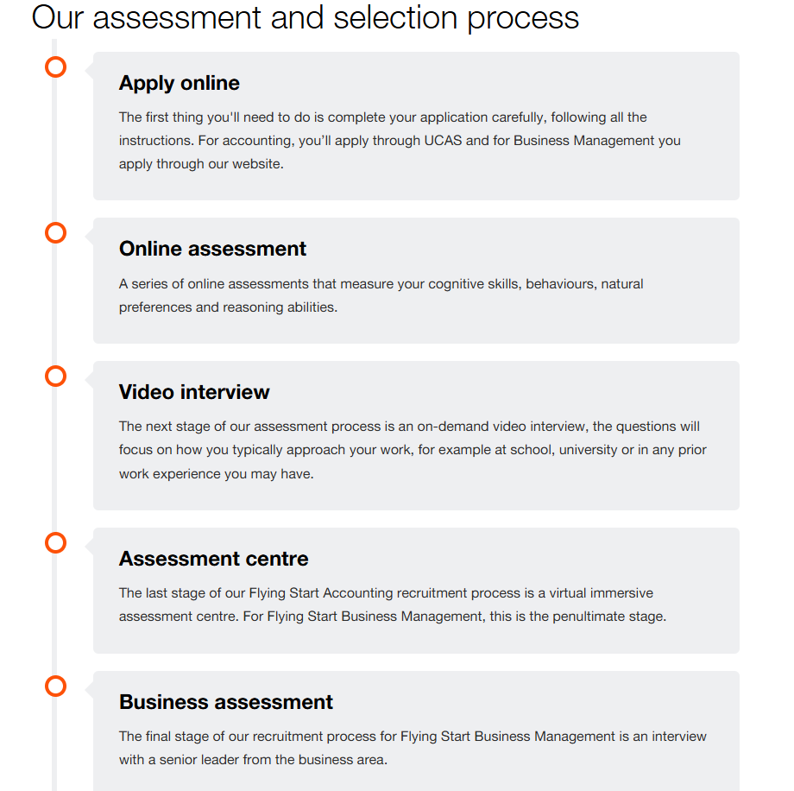

Slide 6
Student Finance
Eligibility - UKCISA - international student advice and guidance - Home or Overseas fees: the basics
Tuition fee loan – fully covers tuition
Maintenance loan - £5000-13000, means tested
Student loan unlikely to cover everything – need to be realistic about how you make it work

Slide 7
Repayments
Not repaid until person is earning significant money
9% of income earned above £25000
e.g. earning £30000 – pay back 9% of £5000 (£450 a year)
Unhelpful to think about as a loan, more accurate to think about as a graduate tax

Slide 8

What is UCAS?
University and Colleges Admissions Service
Co-ordinates all UK applications
Students apply to 5 different Universities
Choose one firm and one insurance offer

Slide 9
UK wide trends
2024 – 36.4% of UK 18 year olds applied for University
Lower numbers of EU applications, volatile international applications
High tariff universities significantly harder to get into

Slide 10
Reading School data
2025 – 99% of students got at least one offer, 86% got at least 3 offers, 27% 5 offers
Approximately 50% of students are early entrants
12-20 Year 14 applicants
Offer Rate – 74%
Notes:
80% offers from Russell Group universities

Slide 11
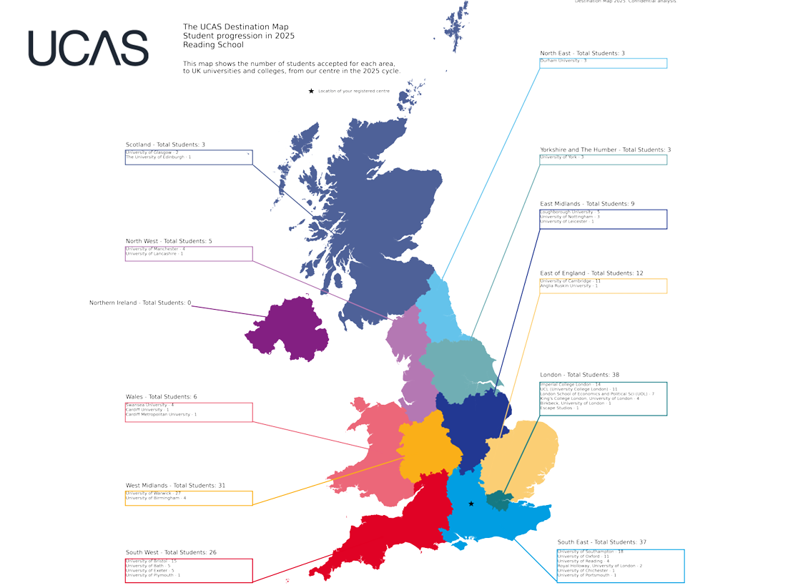

Slide 14
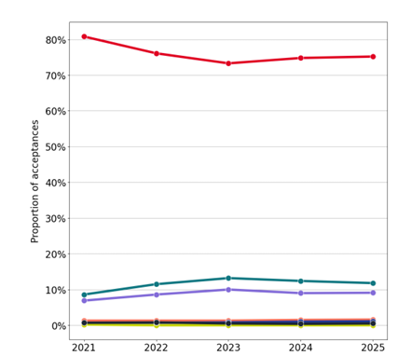

Slide 15
Start thinking
Next Steps days
Make decisions
Personal statement
Submit application
Send application
Now
July
Summer
September
October

Slide 16
Interviews and admissions tests
Receive offers
Decide on Firm and Insurance options
Receive A-Level results and confirm University place
November-December
October - May
March-June
August

Slide 17
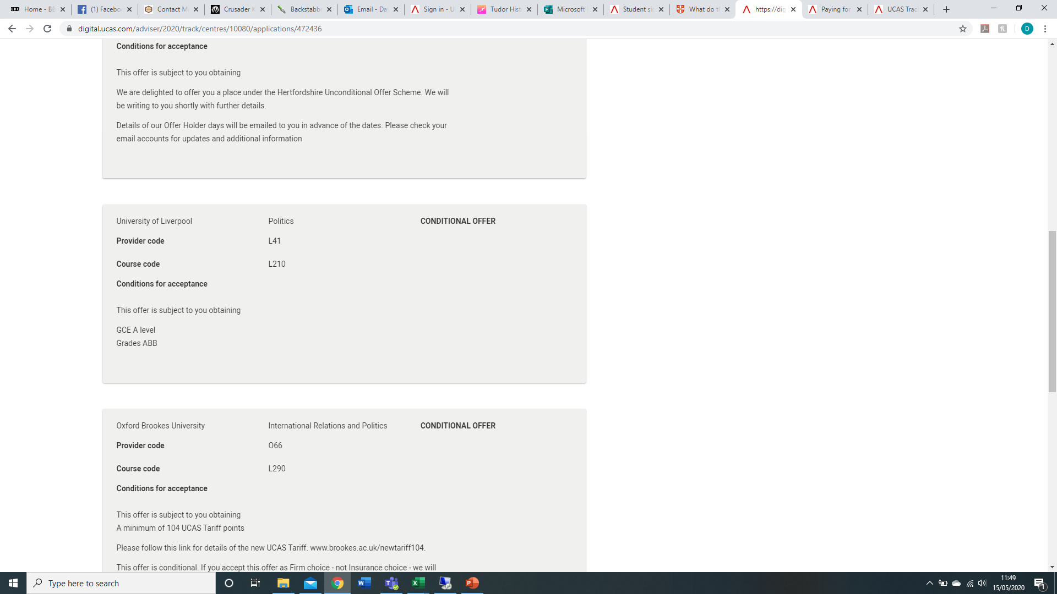
Offers
Firm – if you meet the conditions of your offer, you will be given a place at that university
Insurance – If you miss your firm conditions, but meet your insurance conditions you will be given a place at your insurance
All other offers are rejected

Slide 18
How do universities make decisions
Achieved grades (GCSEs)
Predicted grades (A levels)
Personal Statements and References
Contextual Information
Admissions tests/interviews/Portfolios etc.

Slide 19
Personal Statement
Predicted Grades
Reference

Slide 20
Personal Statements
New structure this year
Opportunity to write about your subject
Must be honest and your own work
Form tutor as main editor
Can be checked by one subject teacher
Use unifrog

Slide 21
Personal Statements
Personal statements for 2026 entry onwards | Undergraduate | UCAS
Why do you want to study this course or subject?
How have your qualifications and studies helped you to prepare for this course or subject?
What else have you done to prepare outside of education, and why are these experiences useful?

Slide 22
Predicted Grades
Optimistic but realistic
Based on evidence
Important but not the only thing

Slide 23
Prediction Process
Predicted grades will be based on work students have done throughout the year
Primarily based on end of year assessments (May/June)
They are not based on what a student needs to get into a particular course/university
Departmental policies on process and opportunities for improvement

Slide 24
References
Written by form tutor
Based on comments from individual subject teachers
Mainly focused on degree
Reviewed by a member of the 6th Form team and finally by the Head Teacher.
Significant changes two years ago

Slide 25
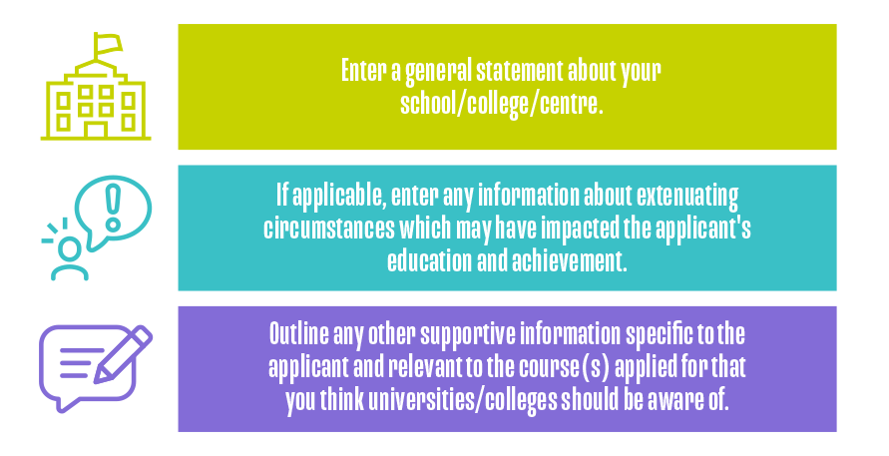
Key information in a reference

Slide 26
Decision Making

Slide 27
Choosing your course
What am I good at?
What do I enjoy?
What can I see myself doing for 3 years (plus)?
Do I want the chance to take a year out (placement\sandwich) or a year abroad studying?
What do I want to do at the end of it?

Slide 28
Choosing your University
Location
Campus/ City
Cost of Living
Distance from Home
Learning Style
Support
Reputation – Oxbridge/Russell Group
Academic Specialisms

Slide 29
Resources
www.ucas.com/parents
Discover Uni Home | Discover Uni
Unifrog - https://ww.unifrog.org
League tables - Complete University Guide - University Rankings, Guides and Courses

Slide 30
Open Days
Students are encouraged to attend open days at the weekend and during the holidays.
Pick visits selectively and after first undertaking appropriate research.
Be aware that they are selling the university to you.
Remember, going to an Open Day will NOT improve your chance of getting an offer.
To find Open days use: www.opendays.com

Slide 31
Competitive Admissions

Slide 33
5 Key Metrics for Oxbridge Applications
“We consider every application individually, taking all aspects into account”:
1. Contextualised Pre 16 academic achievement (64 minimum best 8)
  2. Post 16 Subject combinations and Predictions (AAA at least)
  3. UCAS Personal statement and reference
4. Admissions test results
(where required – BMAT, TSA, PAT etc.)
5. Interview

Slide 34
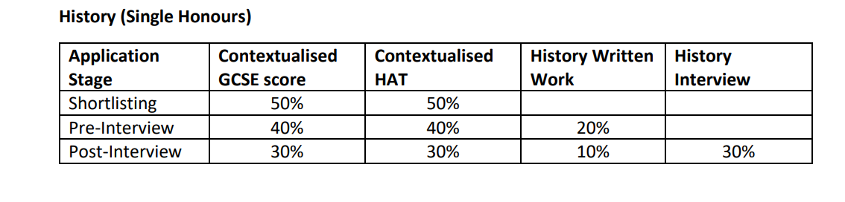
Exemplar decision-making process
Predicted grades not considered
Admissions tests and interviews make up 60% of the decision making process

Slide 35
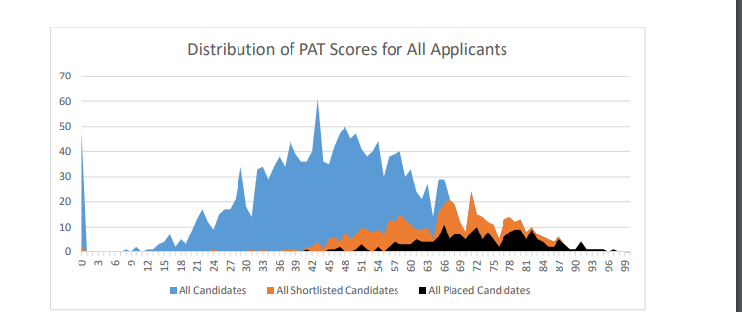

Slide 36
Admissions tests
Take place in October (apart from LNAT and UCAT)
They are sat outside of school
Speak to Mr Cooper

Slide 37
Interview
Take place in December
Primarily focused on your academic ability and your interest in the subject
You will be offered mock interviews with alumni and staff
Prepare now – Get interested in your subject

Slide 38
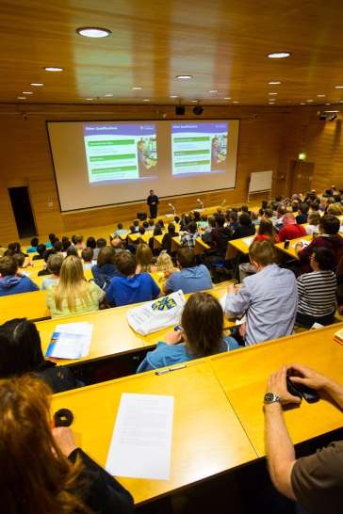
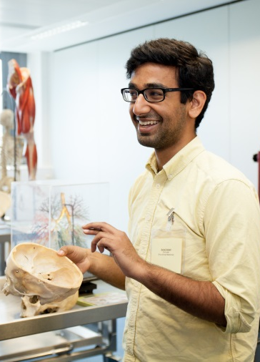

Common Pitfalls in Competitive Admissions
Wrong subject
Track-record in exams causes concern
Inconsistent UCAS reference
Thin UCAS Personal Statement - Lack of super curricular exploration
Lack of practice for admissions tests – Lack of awareness of time pressure
Interview challenges
  Subject knowledge insecure
  Insufficient analytical ability or clarity of thought
  Unwillingness to re-think ideas in the face of contrary evidence

Slide 39
Likelihood of offers
No offer is guaranteed
70+ best 8 GCSE and at least A*A*A predictions
Must have a spread of applications
Imperial, UCL, LSE, Durham, St Andrews equally difficult

Slide 40
Medical Applications
Join MedSoc
Talk to Ms Pickering
Interviews, admission tests and work experience very important

Slide 41
USA and beyond
A growing area in post-school destinations.
Students should make it clear as early as possible that they are considering this. It is a very convoluted process and students need to give staff as much notice as possible.
This needs to be very student driven

Slide 42
Final advice
Select the 5 courses that you’d be happy to study.
Look carefully at the subject requirements for GCSE
You get two choices – a firm and an insurance one. Theinsurance needs to be lower than the firm choice soyou need to think about having a spread of offers.
If Year 13 goes well, are you likely to have an offerwhich you’d want to accept?
If Year 13 goes badly, are you likely to have an offerwhich you’d want to accept?
It’s your future, not your parents’. Make sure you makethe choice for the right reasons.

Slide 43
Thanks for listening
Any questions – please complete the attached Microsoft form
https://forms.office.com/Pages/ResponsePage.aspx?id=QKRT3Wr9XkC75lKx5h6C29RQ06GFNbVBtycxL2bJZ0BUREhOR0MxRDlFUFdZQU9OMlVSNVk2SkMxNS4u
If you would like to discuss things further, please drop me an e-mail dwhitehorn@reading-school.co.uk

