Slide 1

Your Safety and Wellbeing at Reading Festival 2024

Slide 2
PLAN YOUR WEEKEND

Slide 3
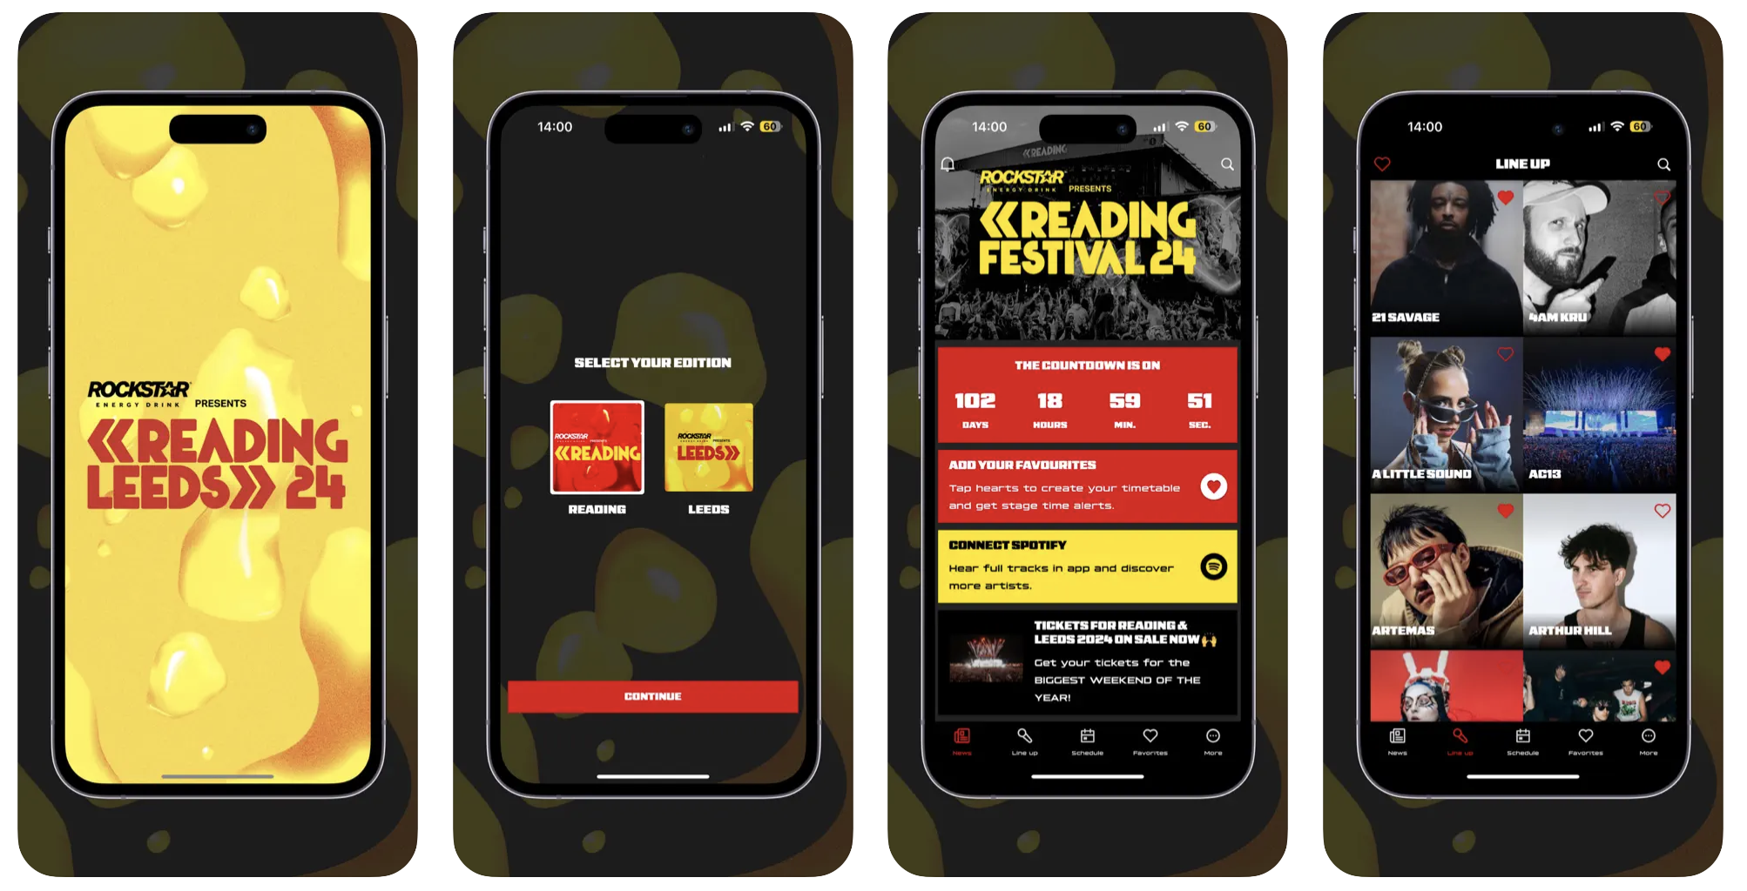
Install the Reading and Leeds Festival app before you go
Notes:
Signal can be inconsistent on the festival site – install the app in advance (when you are on site, try using text or phone calls instead of internet-based services).

Slide 4
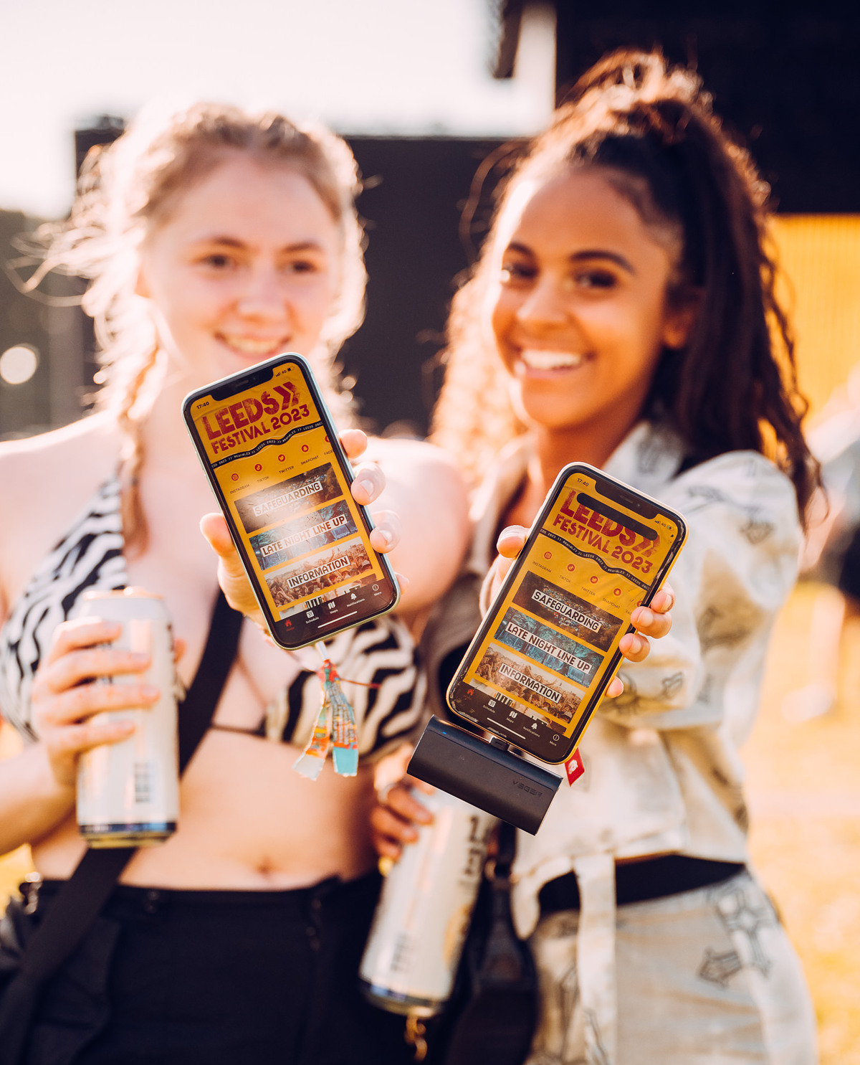
Install the Reading and Leeds Festival app before you go
Signal can be inconsistent at the festival site
Install the app in advance
On-site, use text or phone calls instead of internet-based services.
Notes:
Signal can be inconsistent on the festival site – install the app in advance (when you are on site, try using text or phone calls instead of internet-based services).

Slide 5
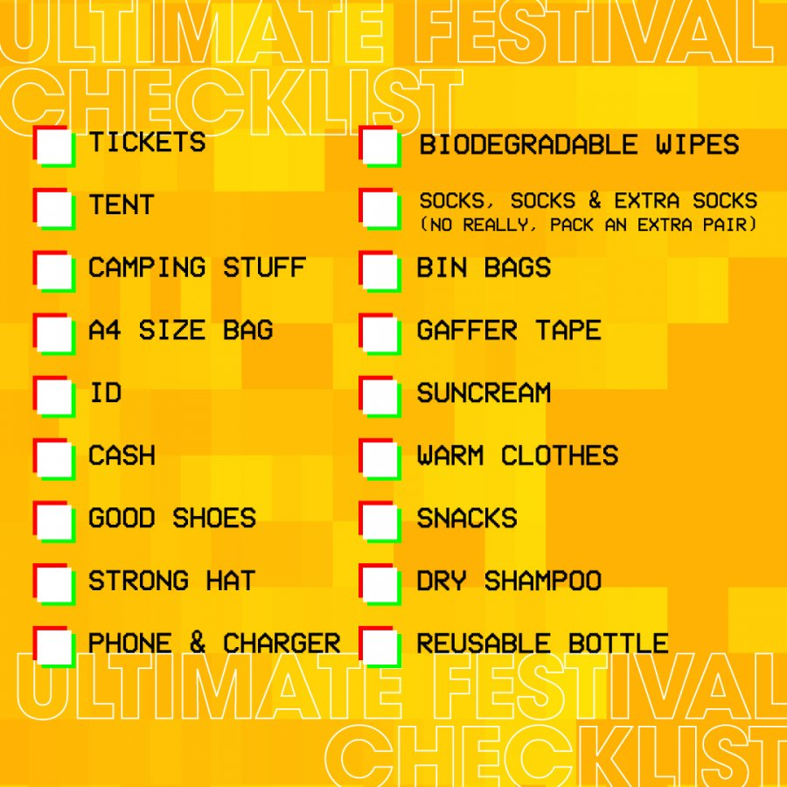
Pack all essentials

Slide 6
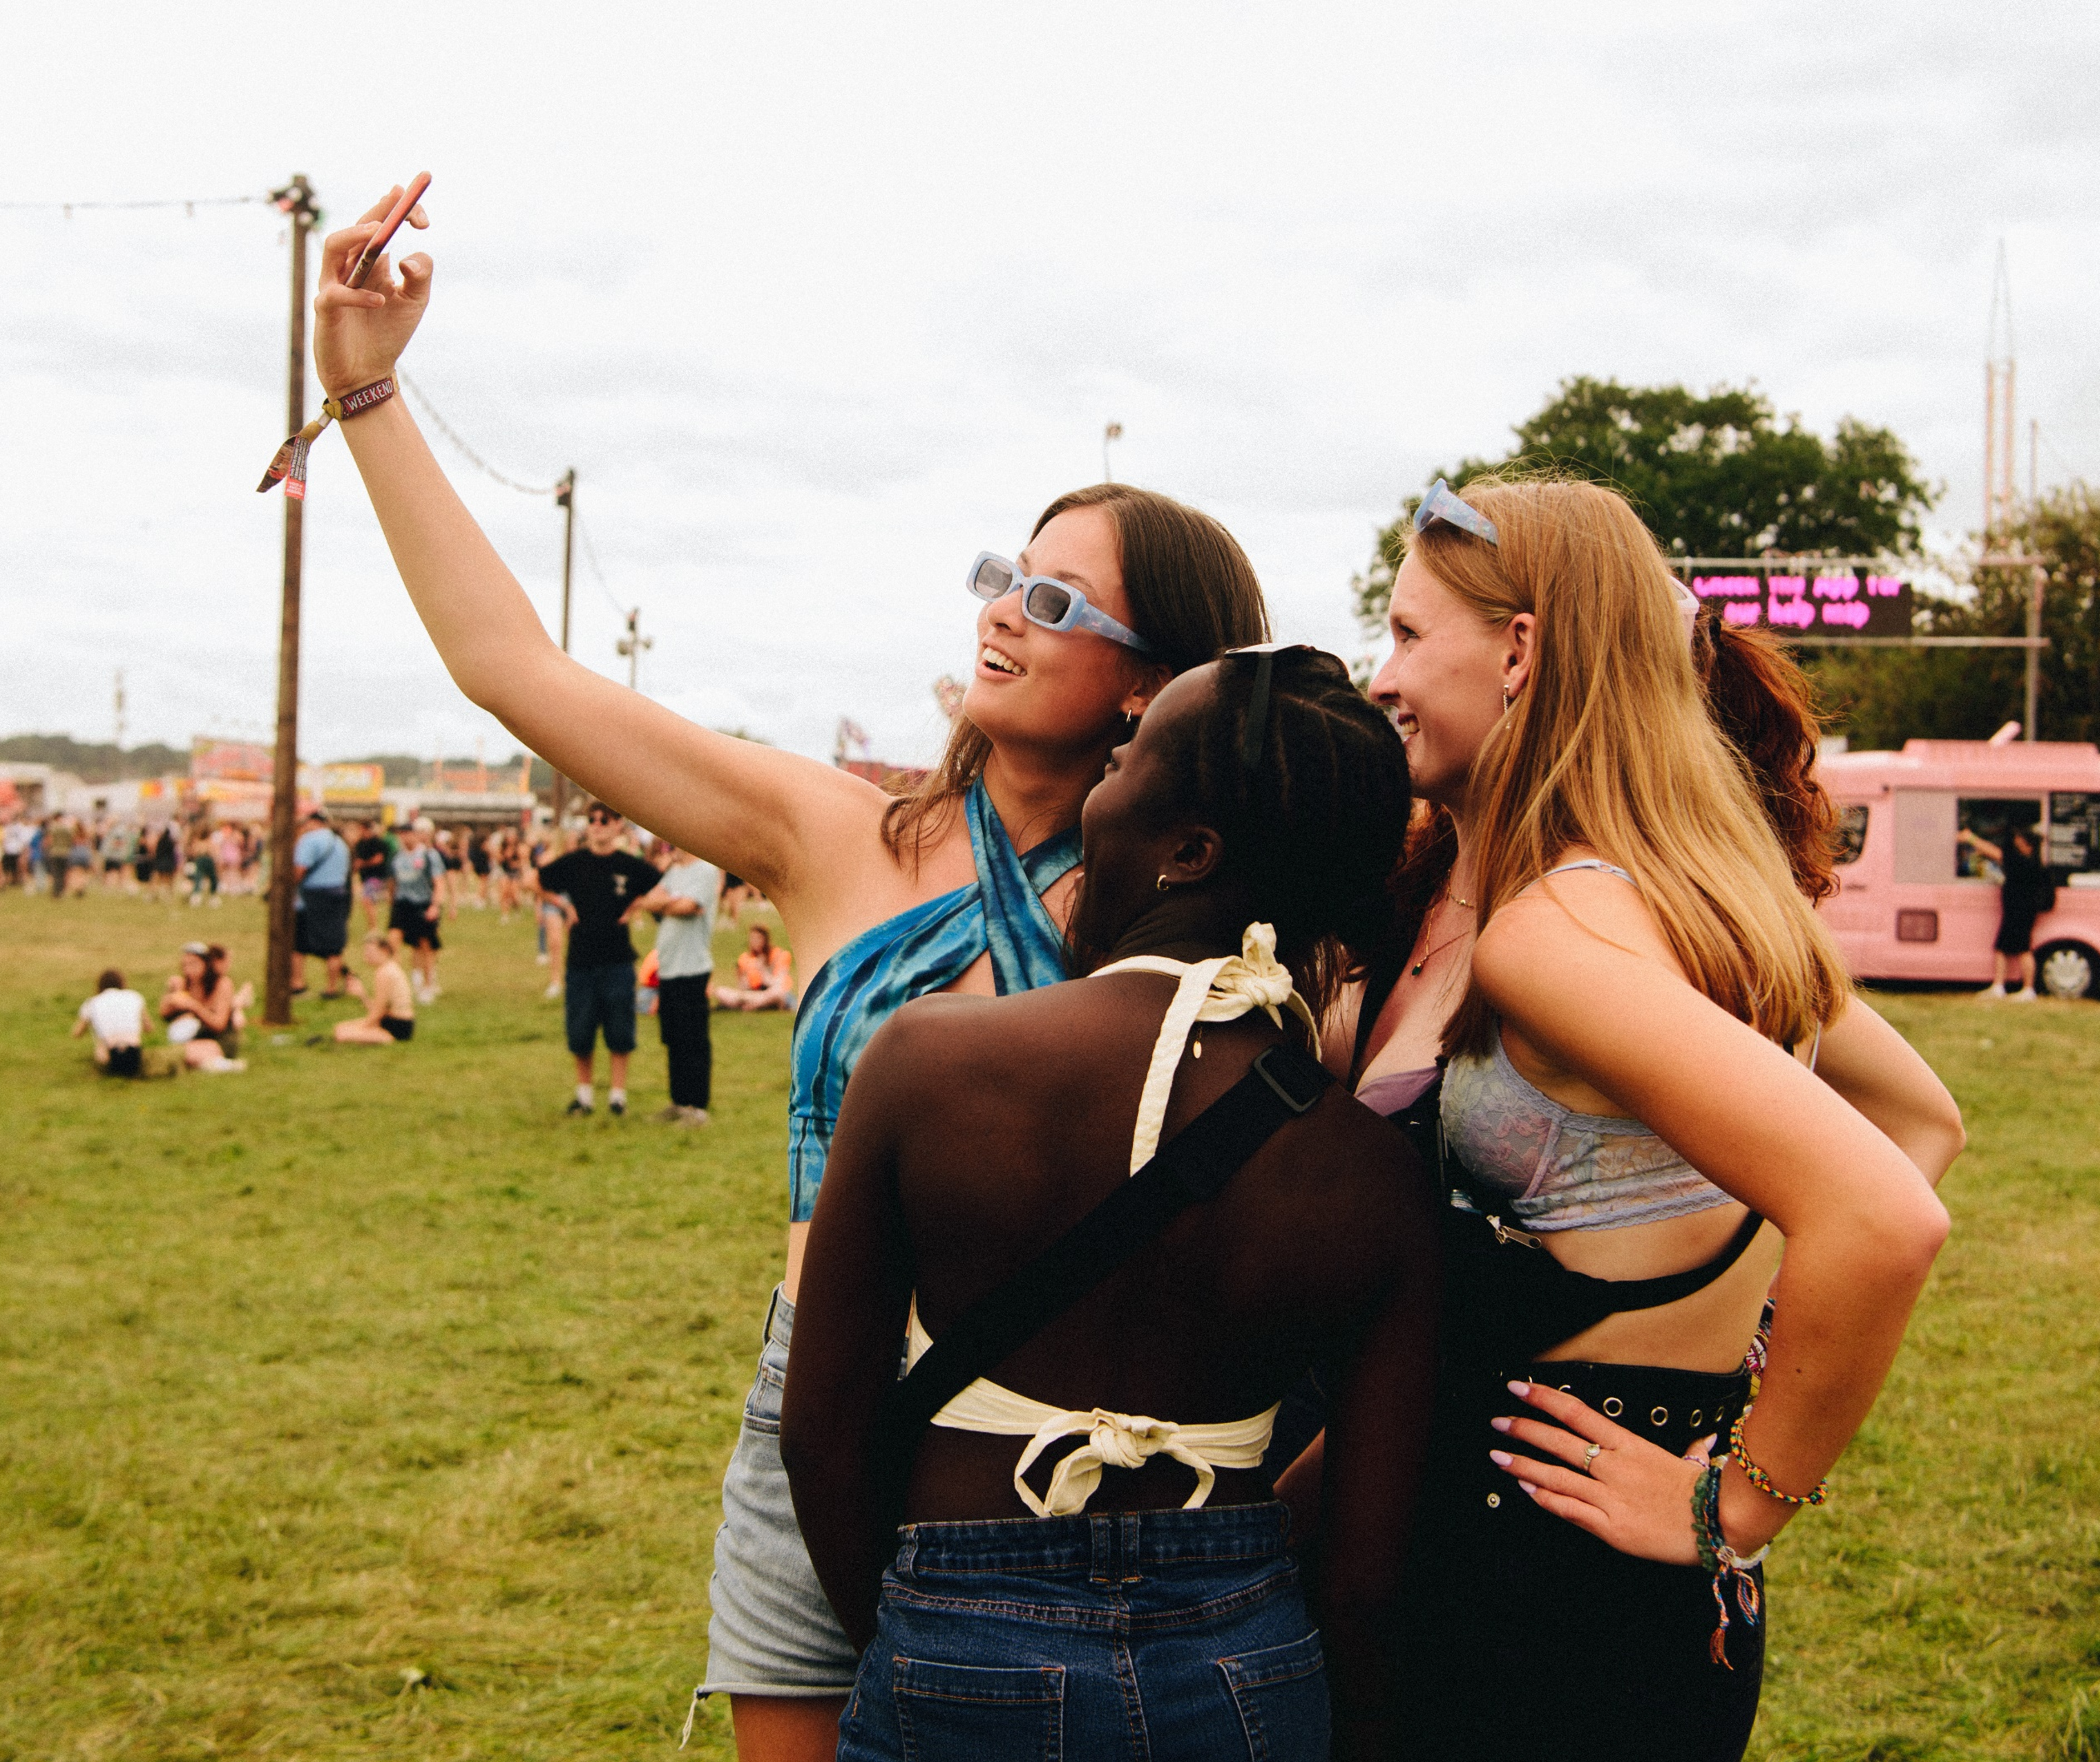

Stay connected to home
Stay up to date with your family by texting and phoning them regularly.

Slide 7
REMEMBER WHO CAN HELP

Slide 8
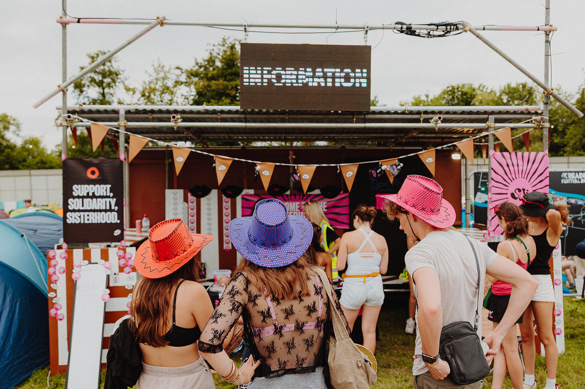
#LookOutForEachOther
Stay with your friends!
If you notice anything, go to security as quickly as possible
You will not be punished if you have got something wrong.

Slide 9
Help map
Explore the map and know what support is available
For urgent or non-urgent help, go to the welfare/medical tent or an AIR Hub
Ask any staff member for directions - they are trained to help
Notes:
Familiarise yourself with help map – save on phone. Highlight medical/welfare tents (THIS WILL BE UPDATED PRIOR TO THE FESTIVAL).
Any member of staff can direct to welfare/medical tent at any time. Explore the map and know what is available!
If you need urgent or non-urgent help, talk to the team in the Welfare/Medical Tent – you can ask any member of staff to direct you towards them. They are trained and will help you.

Slide 10
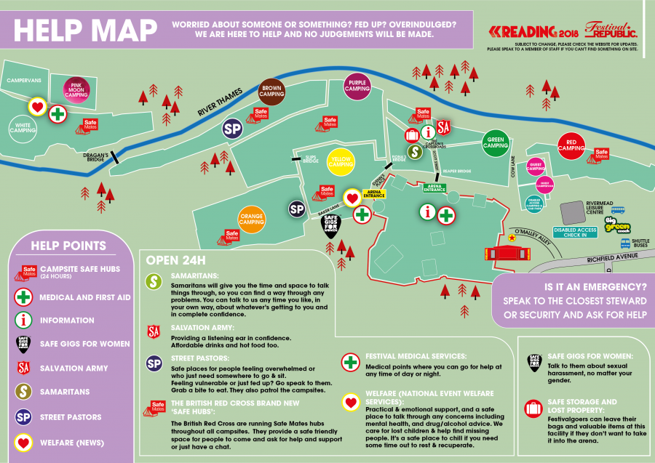
Help map

Slide 11
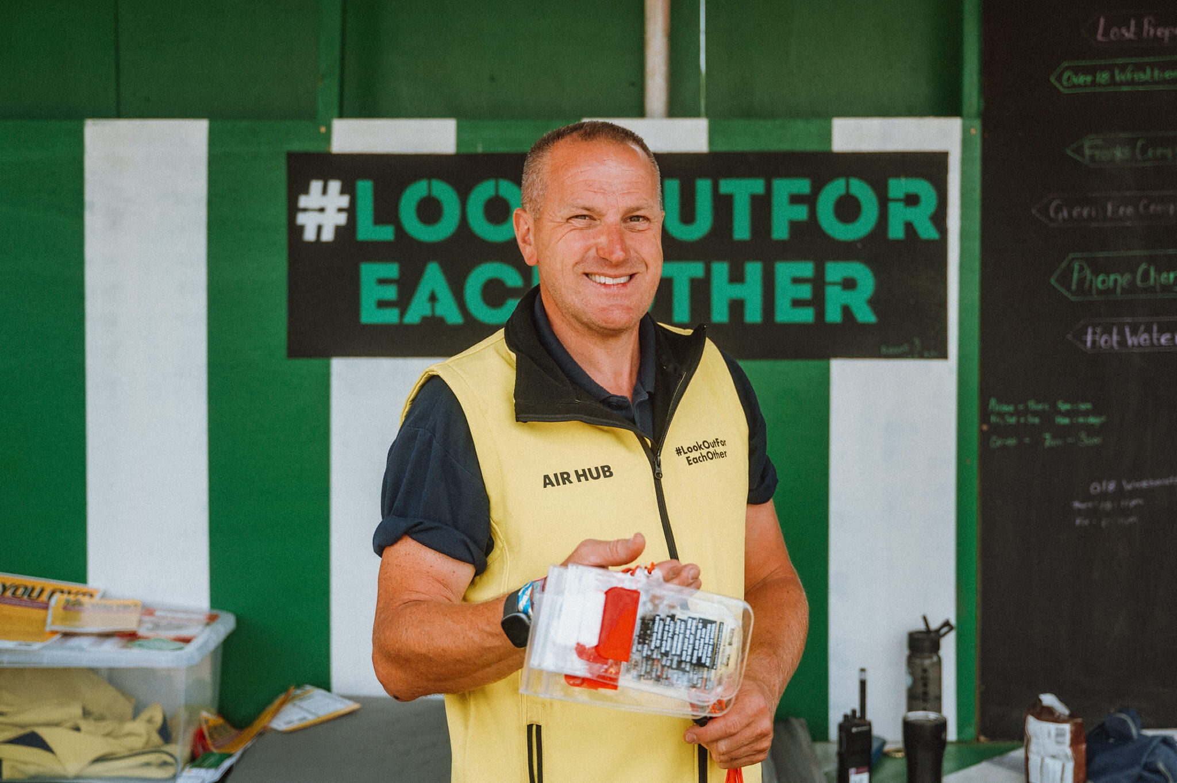




AIR Hubs
Notes:
There are also lots of Assistance, Information and Response (AIR) Hubs across the site, these are all staffed by local/national charities and groups – including some who are teachers in Reading!

Slide 12
Things to remember at the festival

Slide 13
Is the festival the best place for you to be?
Festivals can be overwhelming, especially for first-timers
It's okay to leave or go home if it feels like too much
Taking a break at home and returning later is fine
Plan your travel to avoid late nights or early mornings alone
Notes:
Festivals can be overwhelming places to be, especially if it is your first time at one. Remember that they are supposed to be fun, and there is no shame in walking away or going home if you feel like everything is becoming too much. Also 4-5 days is a long time! It may be that you need a break and can either relax at home or have a break and come back when you are feeling better. It is also worth considering when the best time may be to travel (e.g., avoid travelling outside of the festival site late at night or in the early hours of the morning unaccompanied).

Slide 14
Do you need a break?
Reading Festival is close to the town centre
There are many activities in Reading to help you relax, like going to the cinema, swimming, or eating some nice food
Consider taking a break from the festival to enjoy these activities
Notes:
Reading Festival is unusual compared to most other festivals, as it is a short walk to the town centre. There are a range of activities and places to go in Reading, and if you know that there are activities that make you feel more relaxed (e.g., going to the cinema, swimming, eating tasty food), it may be helpful to consider taking a break from the festival and seeking these out.

Slide 15
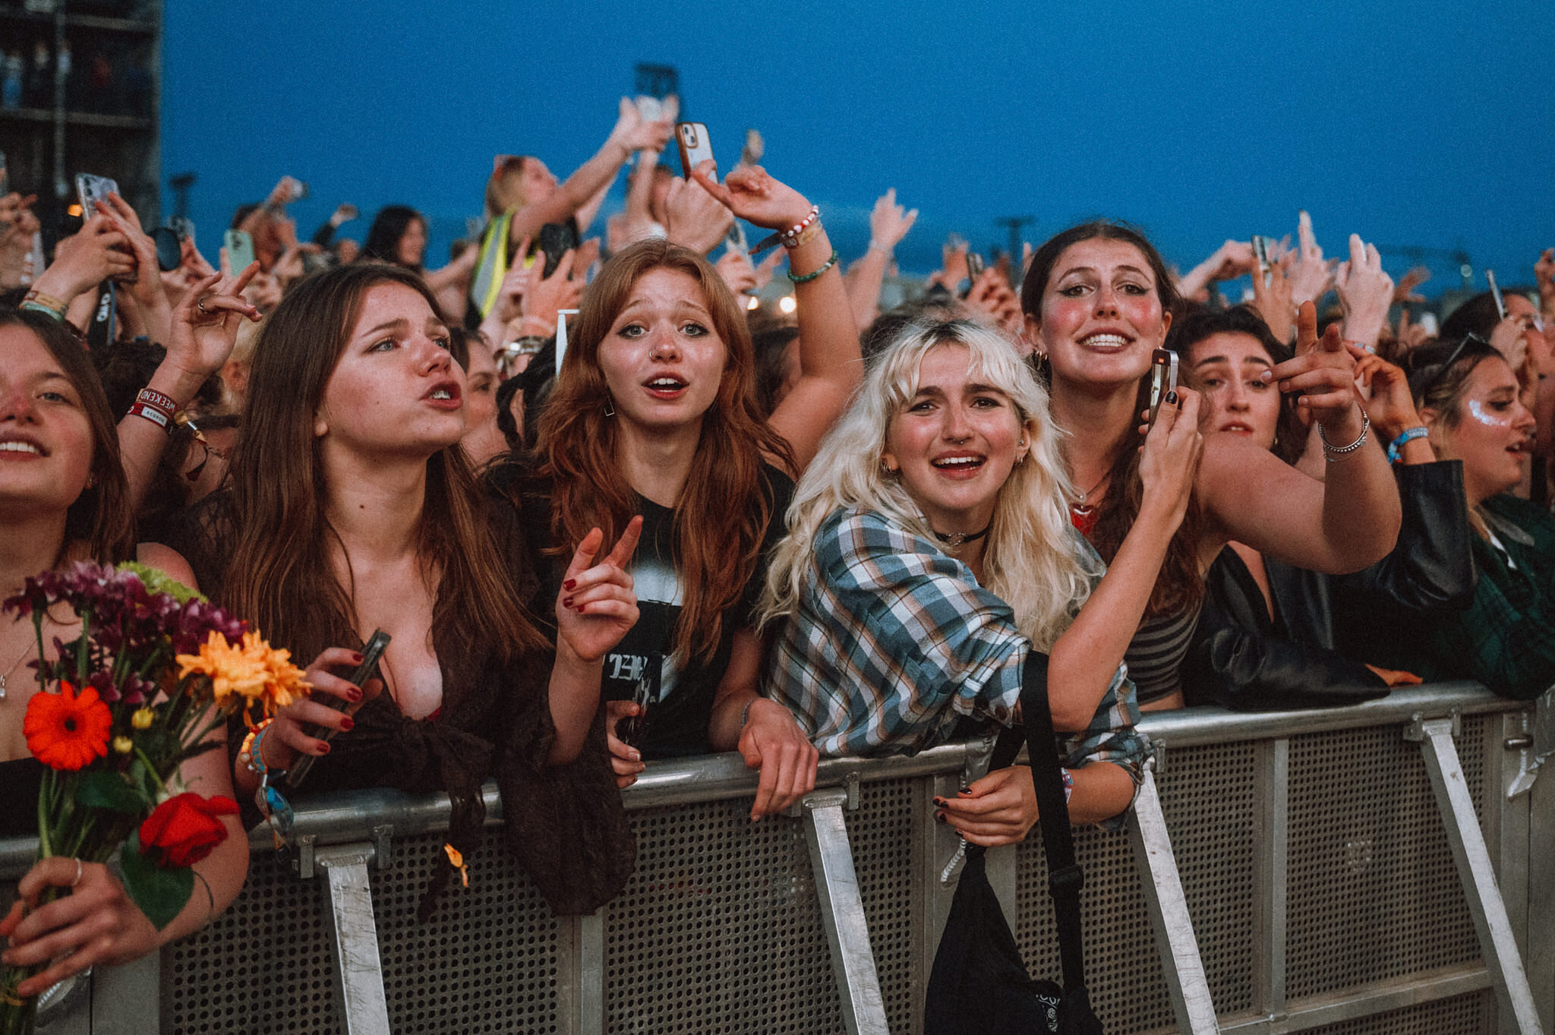
It is normal to have a range of feelings
Notes:
At festivals you may experience some of the highest highs and lowest lows, especially if you have just come out of a stressful time (like exams)! Take care of yourself and remember that it is OK not to be OK. Ask your friends for advice and keep in close contact with your support networks.

Slide 16
It is normal to have a range of feelings
Festivals can bring the highest highs and lowest lows, especially after stressful times like exams
Take care of yourself and remember it’s OK not to be OK
Ask friends for advice and stay in touch with your support network
Notes:
At festivals you may experience some of the highest highs and lowest lows, especially if you have just come out of a stressful time (like exams)! Take care of yourself and remember that it is OK not to be OK. Ask your friends for advice and keep in close contact with your support networks.

Slide 17

Substances are not your friend!
You may experience peer pressure or feel like you want to take alcohol or drugs to avoid feeling distressed, but this can easily go wrong and tomorrow they will make you feel worse.

Slide 18
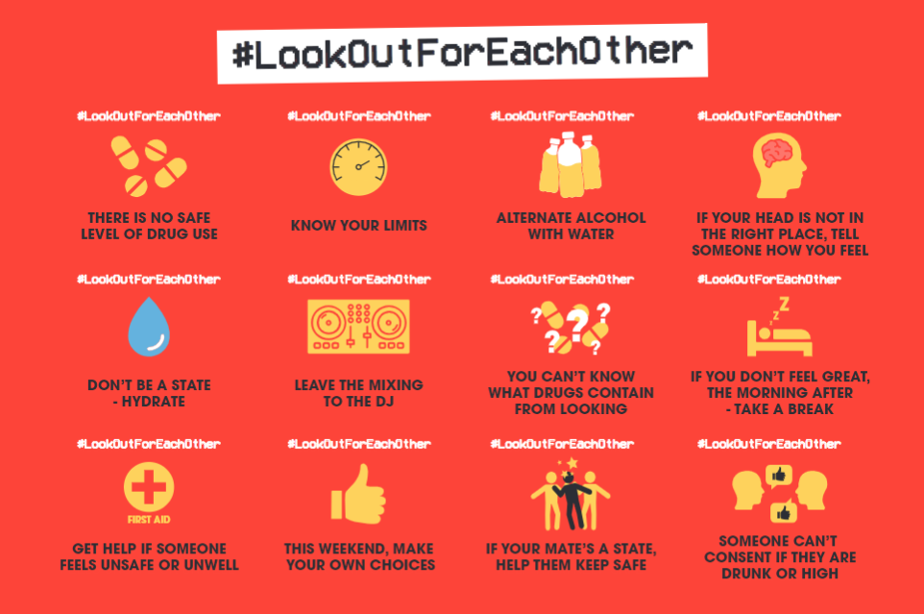

Slide 19
Other support that you might find helpful

Slide 20
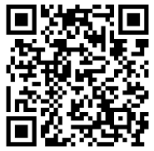
TellMi app
Tellmi is an NHS commissioned digital peer support app
There are 600+ mental health self-management tools accessible 24/7
You can install the app by visiting www.tellmi.help or searching
App Store/Google Play

Slide 21
If you need emergency support
Text ‘SHOUT’ to 85258 for 24/7 immediate support with your mental health (if you are off site/are not able to access an AIR Hub or the welfare team)
If you are off-site and cannot access an AIR Hub/welfare tent or you feel you’re in danger, call 999.
We recommend you save SHOUT’s number to your phone 85258.
Notes:
Text ‘SHOUT' to 85258. Shout 85258 is a 24/7 UK text messaging service for times when people feel they need immediate support.
The Emergency Duty Service can be contacted at any time on 01344 351999.
You can save these numbers to your phone.

Slide 22
Signs to notice when looking out for friends
If you notice any of these signs, you may want to seek advice from the welfare tent or an AIR Hub.
Sudden changes in behaviour or mood
Slurred speech or difficulty walking
Dizziness
Shortness of breath
Unresponsive
Loss of coordination or balance
Vomiting or extreme nausea

Slide 23

Example of an emergency
One of your friends feels isolated and depressed. One evening he tells you that he’s thinking about self-harm and even ending his life.
Immediately look for professional support alert the nearest welfare/ medical staff or contact SHOUT or call 999
Do not leave your friend alone
Stay with them until help arrives and try to provide any information you can to the responders.

Slide 24
Lastly – festivals are meant to be fun, enjoy yourself!

