Slide 1

AI Applications in Healthcare in LMICs
A review of its potential and challenges
Tads Ciecierski-Holmes

Slide 2
Outline
What do we mean by AI?
What use cases are there in LMICs?
Does AI actually help in LMICs?
How to go about producing effective AI tools
Challenges and Opportunities for the future
Notes:
Example, I asked ChatGPT to generate an image of an AI doctor. Plot line of panto
App – likely a scam app that doesn’t work, but there are real examples out there

Slide 3
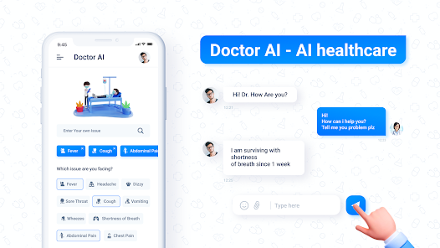
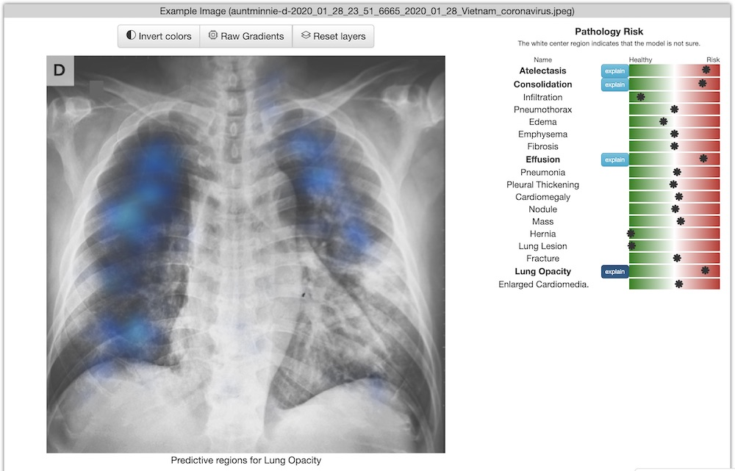
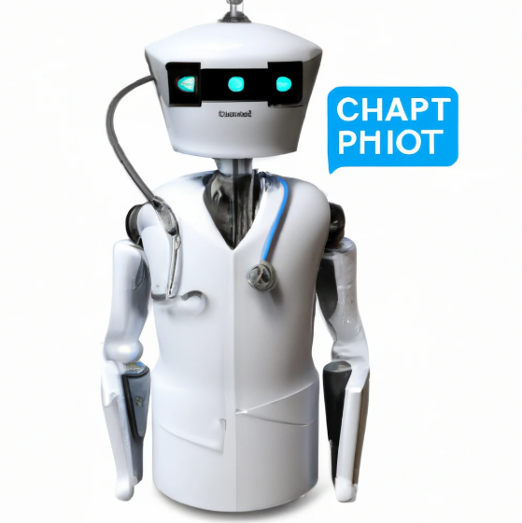
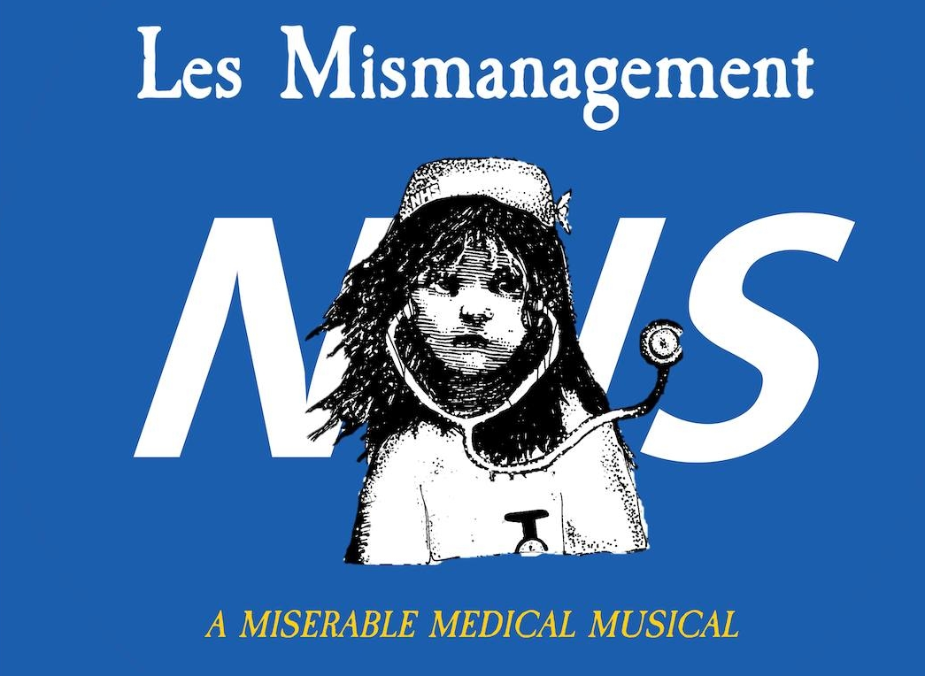
What do we mean by AI?
“designing and building intelligent agents that receive percepts from the environment and take actions that affect that environment” (Russel and Norvig, 2002)
Notes:
Example, I asked ChatGPT to generate an image of an AI doctor. Plot line of panto
App – likely a scam app that doesn’t work, but there are real examples out there

Slide 4
Some terms to be familiar with
Black Box Algorithms – Cannot interpret how inputs are converted into their respective outputs
Training Data – Data used to produce predictive algorithms
Bias – Systematic errors in the predictions of models. This can be introduced due to poor data and poor modelling techniques
Transparency – Degree to which the data and modelling techniques for a given AI tool are available
Reliability – dependability, trustworthiness, and ability to perform consistently well
Robustness – ability to perform without failure under a wide range of conditions
Notes:
Example, I asked ChatGPT to generate an image of an AI doctor. Plot line of panto
App – likely a scam app that doesn’t work, but there are real examples out there

Slide 5
What are the use cases?
Notes:
Concordance - AI found and labelled things that physicians would agree with (breast cancer lumps, segmented body parts of CT, TB on chest Xrays)

Slide 6

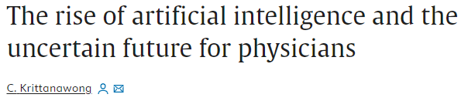
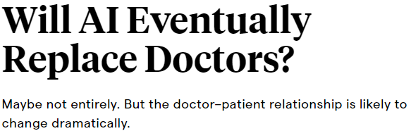

The Hype
Notes:
I think a lot of the superficial discussion is about substitution of healthcare workers

Slide 7
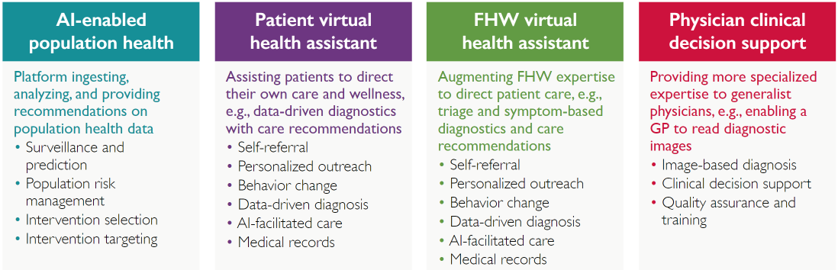
The Real Use Cases
Source – Artificial Intelligence in Global Health: Defining a Collective Path Forward, USAID,
https://www.usaid.gov/cii/ai-in-global-health
Notes:
Note these are all healthcare augmenting and complimentary to existing work-force as ‘assistants’

Slide 8
What examples can be found in LMICs?
Disease Outbreak Prediction
Close contact catcher using population surveillance
Patient retention prediction in HIV care
Diabetes risk prediction tool
Health chatbots
Intelligent triage systems
Notes:
Bluedot = infectious disease outbreak detector and predictor, used by ASEAN countries
Diabetic retinopathy deployments in Tanzania and India
Chinese implementaitons of AI powered health chatbots and triage systems
Patient retention tool in South Africa

Slide 9
What examples can be found in LMICs?
Medical robot assistants
Automatic screening calls
Screening tools
Tailored healthcare worker training
Computer assisted diagnostic tools
  Imaging in particular
Clinical decision support systems
Radiotherapy treatment planning tools
Notes:
Only area with widespread adoption/ trials of this technology is China: everywhere else there are sporadic smaller projects
Tailored training – Burkino Faso

Slide 10
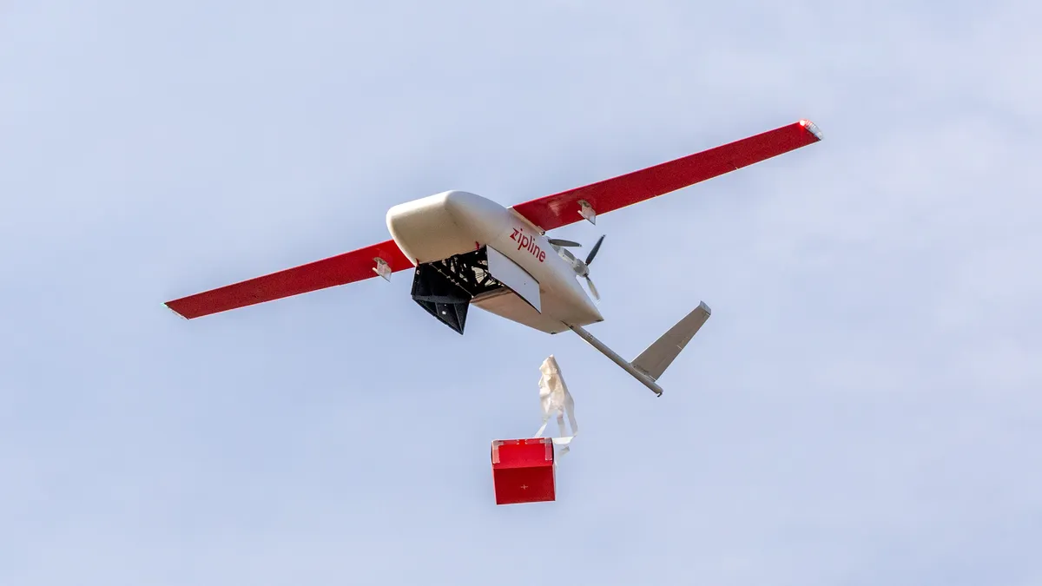
What examples can be found in LMICs?
Notes:
One more famous example – automated drones flying blood products to health centres

Slide 11
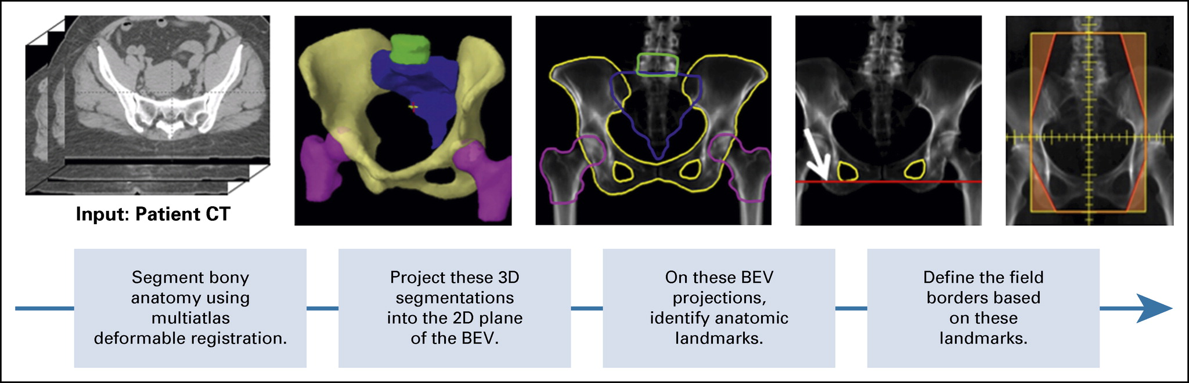
Use cases in LMICs
Kisling et al. (2019), Fully Automatic Treatment Planning for External-Beam Radiation Therapy of Locally Advanced Cervical Cancer: A Tool for Low-Resource Clinics, JCO Global Oncology, https://doi.org/10.1200/JGO.18.0010
Notes:
Automated radiotherapy planning assistant (Radiation Planning Assistant) – starting deployments in South Africa
CarinaAI used in Uganda Cancer Institute https://www.carinaai.com/

Slide 12
Does it work?
Notes:
Concordance - AI found and labelled things that physicians would agree with (breast cancer lumps, segmented body parts of CT, TB on chest Xrays)

Slide 13
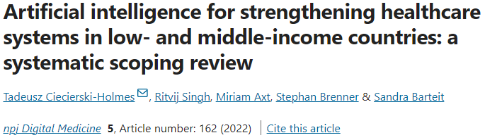
Notes:
Set-out to really understand the evidence of benefit of AI use cases when applied in LMIC settings, not just hypothetical benefit

Slide 14
Features of Included Studies and AI Tools
10 papers identified from screening 1,104 papers
Study Settings - primarily in upper-middle income countries, such as China
AI Applications - patient triage, diagnosis or screening, care planning, and care provision
Transparency of AI tool training data and algorithms – 50% reported each measure
End-users – Mixture of individuals/patients (30%), non-physician healthcare workers (30%), and physicians (50%) with some overlap in end-users

Slide 15
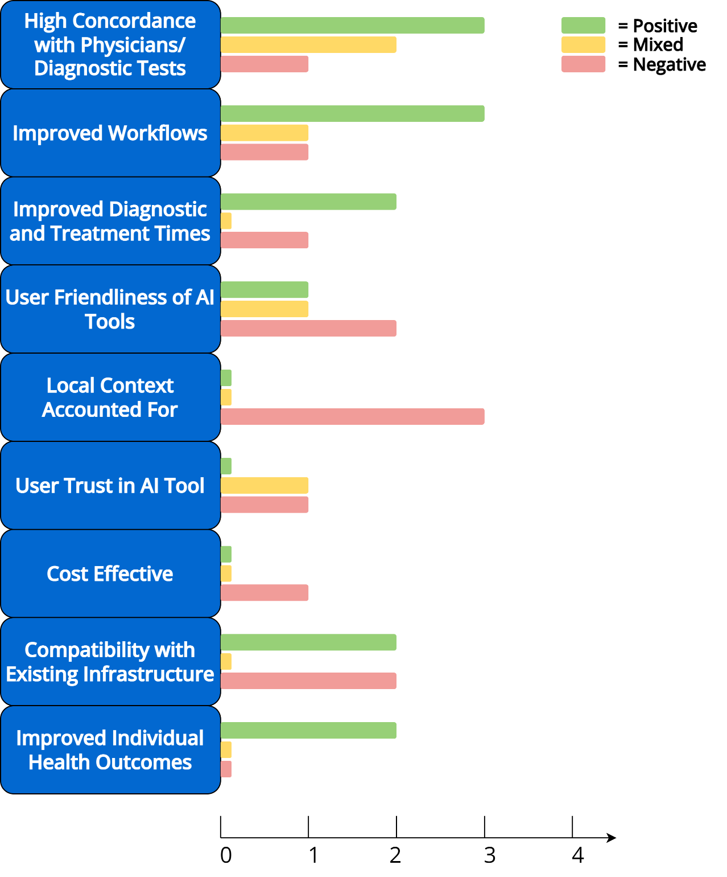
Advantages
High concordance between AI tools and physicians in imaging
Health outcomes improved (when measured)
Mixed Results
Impacts on workloads
Diagnostic times
User friendliness
Disadvantages
Poor trust
Poor accounting for local contexts
Poor concordance and impacts on workflows in some settings
Not shown to be cost-effective
Notes:
Concordance - AI found and labelled things that physicians would agree with (breast cancer lumps, segmented body parts of CT, TB on chest Xrays)
Workload – in imaging was quite good, reduced time to diagnoses in e.g. TB cases since XR much quicker than sputum sample, used during COVID in Ecuador (interesting because used for triage despite very low accuracy); however was not the case in Peruvian hospital where insufficient capacity for uploading XR scans for analysis due to lack of scanner availability and poor internet connection
Diagnostic times – improved in e.g. TB tool, because faster than sputum sample, and meant they could be treater quicker; Chatbots provide quicker access to treatments in the case of a social support chatbot for counselling and positive messaging, but slowed down primary care physicians in a rural health centre in China
User friendliness – other than for one pilot project that helped untrained healthworkers use USS for breast lumps, issues raised included issues for older people using AI chatbot tools, and cumbersome means of accessing the technology (e.g. having to enter very structured data into a CDSS for it to work, or using a tech tool requiring internet connection in a internet poor environment)
Account for local context – 3 varied cases – poor training data in the case of IBM Watson for Oncology (has been discontinued I believe, or dormant), poor accounting for local infrastructure and demands on workforce in TB CXR tool in peru, and likewise for CDSS in rural China did not really address needs of the staff – they are time poor and did not speed up workflow, was used for checking their work in complex cases
Compatibility with local infrastructure – in some cases really easy to implement where smartphone penetration is high – can use app based tools, or where you have a sophisticated IT system to link to medical records and triage systems; if you cannot find interoperability with these systems, or you are introducing tech into an IT poor environment, the tools will struggle to have any positive impact
Cost-effectiveness – very few studies have performed cost effectiveness – as it stands, not shown to be very high; intuitive because really not low-hanging f

Slide 16
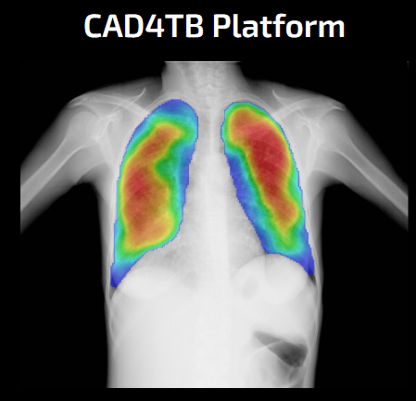
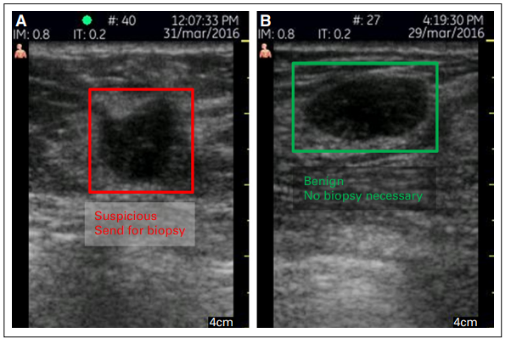
Advantages – High Concordance
High concordance between AI tools and physicians in imaging
CAD4TB (left): https://delft.care/cad4tb/, Love et al. 2018 (right) https://ascopubs.org/doi/pdfdirect/10.1200/JGO.17.00222

Slide 17
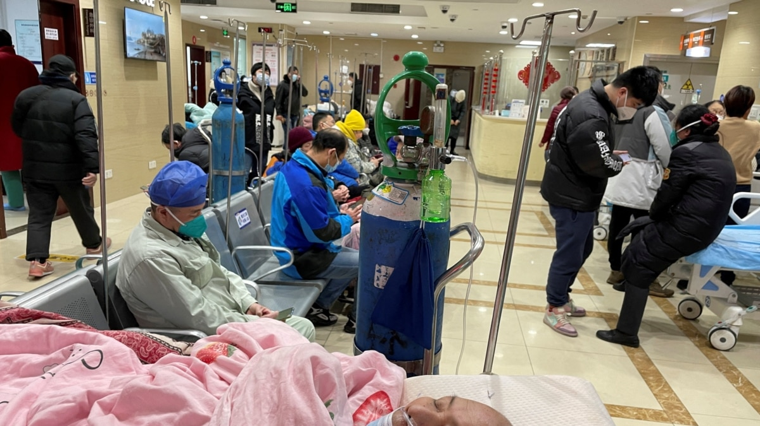
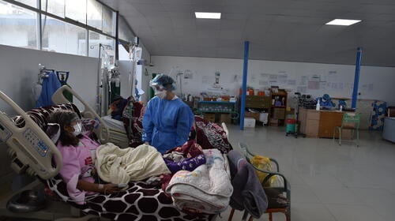
Mixed – Impacts on Workflows
Impacts on workloads varies
Diagnostic times sometimes improved, or were delayed
Some tools were user friendly, others impeded healthcare workers
Notes:
Workload – in imaging was quite good, reduced time to diagnoses in e.g. TB cases since XR much quicker than sputum sample, used during COVID in Ecuador (interesting because used for triage despite very low accuracy); however was not the case in Peruvian hospital where insufficient capacity for uploading XR scans for analysis due to lack of scanner availability and poor internet connection
Diagnostic times – improved in e.g. TB tool, because faster than sputum sample, and meant they could be treater quicker; Chatbots provide quicker access to treatments in the case of a social support chatbot for counselling and positive messaging, but slowed down primary care physicians in a rural health centre in China
User friendliness – other than for one pilot project that helped untrained healthworkers use USS for breast lumps, issues raised included issues for older people using AI chatbot tools, and cumbersome means of accessing the technology (e.g. having to enter very structured data into a CDSS for it to work, or using a tech tool requiring internet connection in a internet poor environment)
LMICs – hospitals have good doctors and equipment, but not enough – dealing with heavy workflows

Slide 18
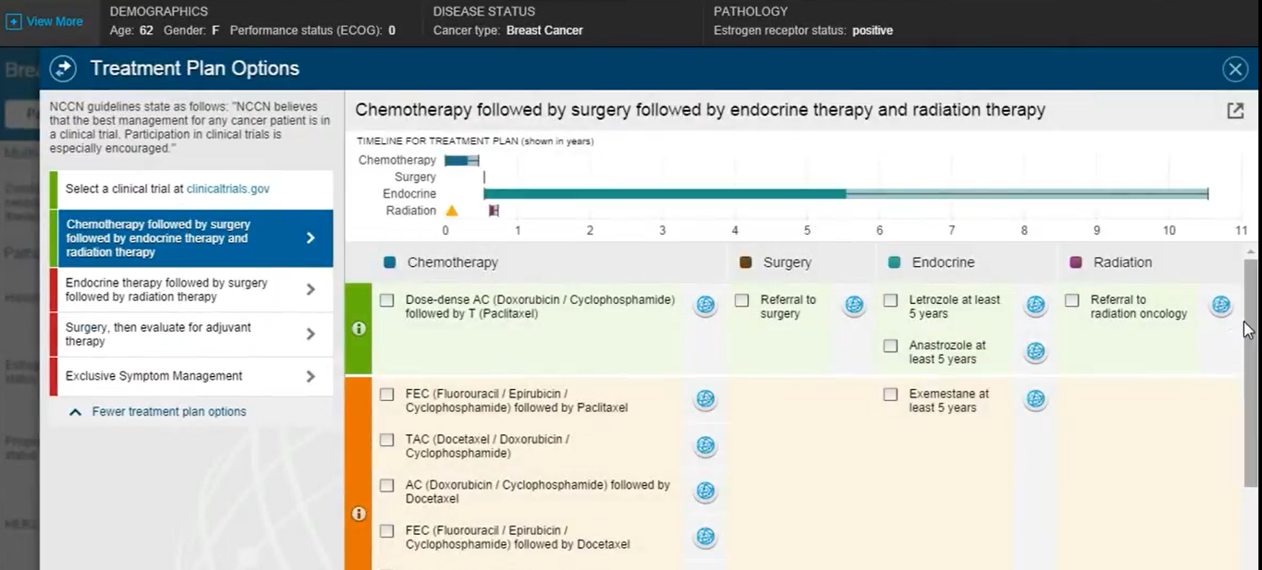
Disadvantages - Accounting for Context
https://www.youtube.com/watch?v=338CIHlVi7A
Notes:
IBM Watson for Oncology Demo – providing treatment suggestions

Slide 19
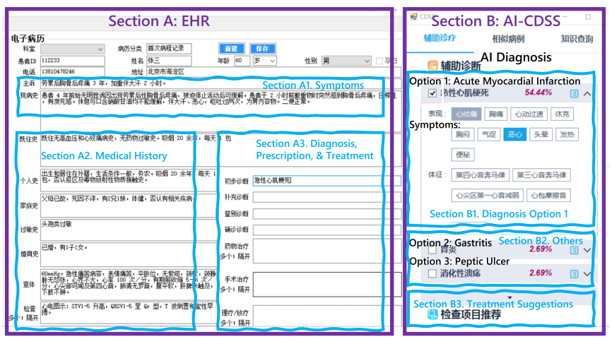
Disadvantages - Accounting for Context
Wang et al. (2021), https://arxiv.org/pdf/2101.01524
Notes:
IBM Watson for Oncology Demo – providing treatment suggestions
Identify examples of tools used in oncology:
* Diagnosis (e.g. radiology, colposcopy for cervical neoplasias, pathology)
* Management (e.g. IBM Watson for oncology, others?, radiotherapy treatment planning)

Slide 20
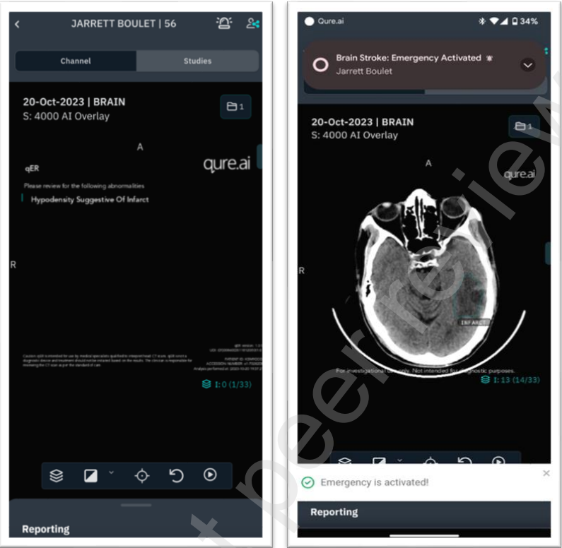
Recent deployments in LMICs
CT CAD for Acute Stroke
qER – manufactured by Qure.ai
89% sensitivity and 99% specificity on Indian sample
PPV – 96%, NPV – 94% on Indian sample
Strengths:
Suggested that it increased speed of treatment
Helped address a lack of in house radiologists
Weaknesses:
Not much information on the cost
Not much information on evaluation from healthcare workers
Chiramal et al. (2024), Artificial Intelligence-Based Automated CT Brain Interpretation to Accelerate Treatment for Acute Stroke in India: An Interrupted Time Series Study, SSRN Preprint, https://papers.ssrn.com/sol3/papers.cfm?abstract_id=4684850
Notes:
Implemented in Indian hospital, appears to work well! Preprint study

Slide 21
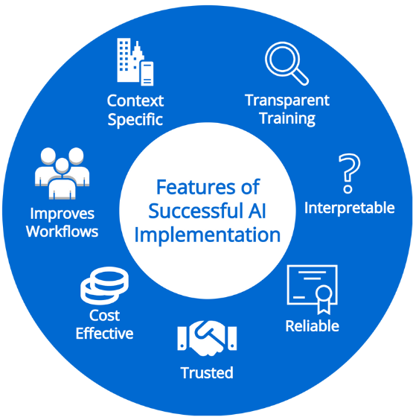

Slide 22
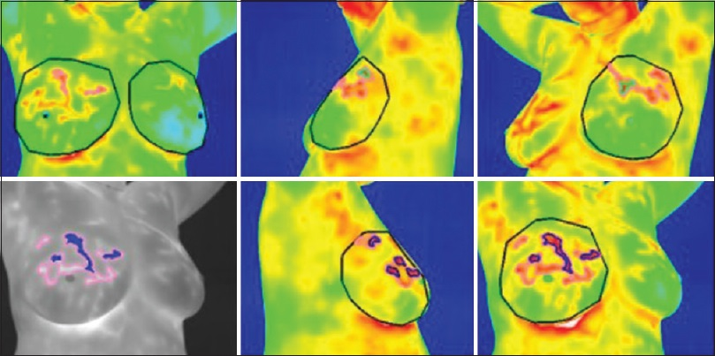
A case study of a recent deployment
Thermal Imaging Breast Screening
Thermalytix:
Positive predictive value 50.71%
Negative predictive value 97.88%
Strengths:
Reducing costs of screening
Easy to use
Weaknesses:
Poor awareness of breast health
USG FNAC unavailability
Shubha et al. (2022), Acceptance of artificial intelligence (AI)-based screening for breast health in urban slums of central Karnataka, India – SWOC analysis, J. of Family Medicine and Primary Care, https://doi.org/10.4103/jfmpc.jfmpc_143_22
Notes:
Used in India
Even if the tool works well and is well supported by local government and healthcare workers, still face challenges on the public health side which may diminish the impact.
This is not to say it’s not great tech, but it’s no silver bullet that will fix breast screening
The tool works, the impact on workflows seems positive, but still have underlying issues with local context for screening and remaining healthcare infrastructure to see improvements

Slide 23
Developing useful
AI tool
Notes:
Concordance - AI found and labelled things that physicians would agree with (breast cancer lumps, segmented body parts of CT, TB on chest Xrays)

Slide 24
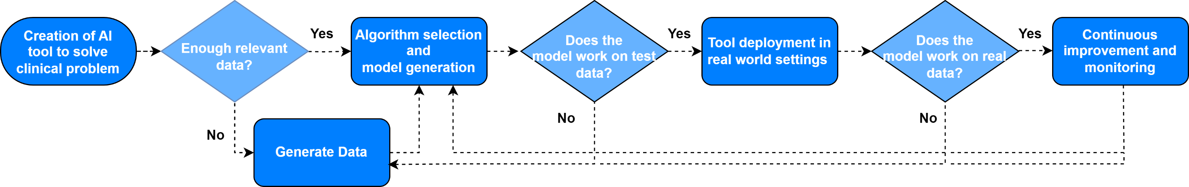
How do you produce a successful AI tool?
Notes:
Create Flowchart
Populate with examples from Makerere AI lab

Slide 25
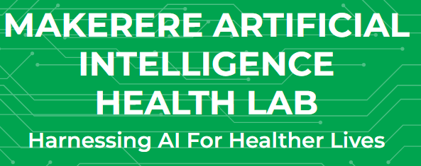
How do you produce a successful AI tool?
Notes:
Create Flowchart
Populate with examples from Makerere AI lab

Slide 26

How do you produce a successful AI tool?
Notes:
Create Flowchart
Populate with examples from Makerere AI lab

Slide 27
How do you deploy a successful AI tool?
Questions raised when deploying an AI tool in healthcare
Does the tool work as expected on local populations?
What are the steps for regulatory approval for an AI tool in health?
Is it a useful investment? Does it improve patient outcomes when used in real-world practice?
Notes:
Create Flowchart
Populate with examples from Makerere AI lab

Slide 28
Practical realities
Digital Infrastructure
Do you have the data to support the training of AI tools?
Will the tool work if trained on data from other sources?
Do you have the IT infrastructure to support such tools?
Workforce considerations
Is there sufficient IT literacy to implement the AI tools?
Can they be trained?
Does the tool improve their workflows, or is it burdensome?
Patient considerations
Do patients trust the tools?
Can patients access the tools?
How is patient data used?
Health Outcomes and
Cost Effectiveness
Does it improve clinical outcomes?
Is it cost effective, vs other potential investments?
Can it be sustainably funded?
Notes:
Discuss issues like IT literacy, healthcare records are still largely paper based, what is the infrastructure for creating datasets of radiology images for different cancers (look into this)
Main points:
There are lower hanging fruit – this is a process. Investing in the IT infrastructure, generating the patient data, using it in research (as part of large relevant datasets), work with clinicians and healthcare workers to figure out the most beneficial and useful tools, which ultimately has to be well integrated into workflows
Investment in other areas may well take priority – AI is unproven in how it may improve clinical outcomes, and has many lingering questions
That being said: some areas are very mature – radiologists can likely use tools very quickly, but there is a question of how well the tools work on the local population. Some testing and using tools cautiously as e.g. ‘checkers’ for missed pathologies, is something that can be used quickly. Likewise in ophthalmology. Radiotherapy treatment planning can likely be implemented quite quickly, and save valuable time so more patients can have their treatments planned.
We are likely a long way off from a tool being able to provide useful clinical diagnoses or management suggestions

Slide 29
Opportunities
Digital Infrastructure
Projects to develop datasets in LMICs
Cloud computing and equipment
Leveraging existing IT infrastructure e.g. mobile phones
Workforce considerations
Workforce training
Involving workforce in development, to maximise potential
Identify areas where AI tools may be most useful
Patient considerations
Public engagement, gain understanding of concerns
Other opportunities
Expanding IT infrastructure investment can lead to cost-savings elsewhere
Scope for partnerships with research institutes and private sector
Is it cost effective?
Can it be sustainably funded?
Notes:
Discuss issues like IT literacy, healthcare records are still largely paper based, what is the infrastructure for creating datasets of radiology images for different cancers (look into this)
Main points:
There are lower hanging fruit – this is a process. Investing in the IT infrastructure, generating the patient data, using it in research (as part of large relevant datasets), work with clinicians and healthcare workers to figure out the most beneficial and useful tools, which ultimately has to be well integrated into workflows
Investment in other areas may well take priority – AI is unproven in how it may improve clinical outcomes, and has many lingering questions
That being said: some areas are very mature – radiologists can likely use tools very quickly, but there is a question of how well the tools work on the local population. Some testing and using tools cautiously as e.g. ‘checkers’ for missed pathologies, is something that can be used quickly. Likewise in ophthalmology. Radiotherapy treatment planning can likely be implemented quite quickly, and save valuable time so more patients can have their treatments planned.
We are likely a long way off from a tool being able to provide useful clinical diagnoses or management suggestions

Slide 30
Predictions and hopes for the Future
This space is very active and changing constantly, so more sophisticated tools are likely to be developed and trialled
  E.g. ChatGPT was released a month after this paper was published
  We hope to provide an update commentary of publications from the past two years
Unlikely to see sweeping changes – effective tools will make subtle improvements to existing practices
  I.e. finding ways to complement existing workforces and infrastructure, not displace them
I hope to see continued efforts to gather evidence of the efficacy of AI tools in healthcare in lower-resource environments
Notes:
Update papers: imaging is very advanced compared to other areas, can see the right circumstances for integrating AI tools into e.g. tertiary centres with appropriate infrastructure, or well thought out screening programmes for e.g. diabetic retinopathy; brief look at newest literature shows advancement of existing projects in e.g. radiation planning assistant, and more studies in lower income countries
Diabetic retinopathy has seen more studies coming out

Slide 31
How to get involved in this work?
As a Medic
  Worth staying aware of developments in AI tools, as they will creep into your work in the future
  Contributing to Quality Improvement projects where you work involving these tools
As a Comp Sci/ Mathematician
  So many opportunities in the space of developing user-friendly UIs, working on the underlying predictive algorithms etc.
As an economist
  Working on programme evaluation and cost-effectiveness analyses to understand whether these tools are good investments
As a sociologist/anthropologist
  Working on understanding how healthcare workers and patients interact with AI tools, so they can be better designed and implemented

Slide 32
Acknowledgements
Many thanks to my supervisors and research team who worked on this paper with me
Dr Ritvij Singh
Dr Sandra Barteit
Dr Stephan Brenner
Miriam Axt
And the Heidelberg Institute of Global Health, including Prof Dr Manuela De Allegri for opportunities working in her group
Thanks to the German Research Foundation (Deutsche Forschungsgemeinschaft) for supporting this work as part of a Deutsche Forschungsgemeinschaft–funded research unit (Forschungsgruppe FOR 2936/project: 409670289) and the “Open Access Publikationskosten“ programme, with additional support by Heidelberg University

