Slide 1
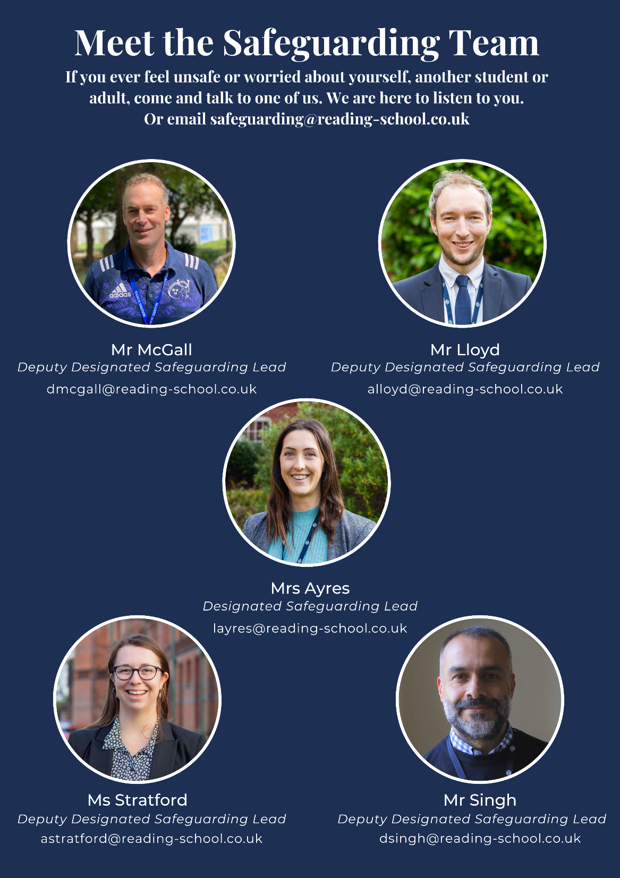

Reading School
Safeguarding and Child Protection
safeguarding@reading-school.co.uk

Slide 2
Keeping Children Safe
Levels of Care
Wellbeing
Safeguarding from harm
Child protection

Slide 3
Safeguarding Overview
Safeguarding is everyone’s duty of care
Prevention is better than being reactive when abuse happens
We work in partnership with other organisations to give holistic view of the child
  home, school, community, social groups, contractors
Children’s Act: Advocacy
  Enabling children to express their views
Involves lots of policies
  Safer recruitment
  H&S, first aid, site security
  behaviour, anti-bullying, e-safety, attendance etc

Slide 4
Spotting Signs of Abuse
You might notice patterns of behaviour in the students you see every day
  eg when strolling up the drive or in the refectory queue or after school by their locker
You build relationships and are in the best position to notice if something does not seem right
  eg a child is unusually withdrawn or disheveled

Slide 5

Look out for changes in a child
The change you see could be a sign of abuse
Difficulty concentrating and not doing as well at school
Mood or behaviour changes
Becoming withdrawn
Tiredness
Mental health needs
Self-harming
Risk-taking behaviour
Using drugs or alcohol
© The Key Support Services Limited
Notes:
Tell staff there are some behavioural signs that are common to different kinds of abuse. Staff should always be alert to these signs, or anything that doesn’t feel right – what’s important is not that they can identify exactly what the issue is, but that they can spot that there might be a safeguarding issue. The most important thing to look out for is a change
Click to bring up each sign in turn:
Difficulty concentrating and not doing as well at school
Becoming withdrawn
Mood or behaviour changes, for example, becoming more irritable, angry, aggressive or clingy
Tiredness
Mental health needs, for example, signs of depression, anxiety, eating disorders or post-traumatic stress disorder
Self-harming
Risk-taking behaviour, such as stealing, bullying, running away, alcohol and drug misuse, sexual activity, trespassing, vandalism, fighting or truancy
Using drugs or alcohol
Sources:
National Institute for Health and Care Excellence (NICE), Child maltreatment: when to suspect maltreatment in under 18s. https://www.nice.org.uk/guidance/cg89/chapter/1-Guidance
NSPCC, Emotional abuse. https://www.nspcc.org.uk/what-is-child-abuse/types-of-abuse/emotional-abuse/
NSPCC, Neglect. https://www.nspcc.org.uk/what-is-child-abuse/types-of-abuse/neglect/
NSPCC, Physical abuse. https://www.nspcc.org.uk/what-is-child-abuse/types-of-abuse/physical-abuse/
NSPCC, Sexual abuse. https://www.nspcc.org.uk/what-is-child-abuse/types-of-abuse/child-sexual-abuse/

Slide 6
Children’s Safety
Children’s Worries (NSPCC)
We must make sure we pass on concerns, to keep children safe
How much is not recorded or reported?
  How many never tell anyone about their concerns?
  How many never tell until adulthood?
  If the adult disclosed to doesn’t follow processes?
  If the adult disclosed to doesn’t pass on?
Children have lots of worries. What things do children worry about, according to an online survey?
Bullying, including online bullying
Body image
Mental health
Crime victim
Environment
Wellbeing and safety of loved ones

Slide 7
Reading School Policy:
Dealing with concerns
If you…
  Receive information from the child that puts them at risk of harm
  Have suspicions they may be at risk of harm
  Receive allegations of abuse
  Or interpret allegations of abuse
Do not investigate suspicions
Record (child’s quotes, date, times)
Refer IMMEDIATELY to the Designated Person who will liaise with local authority

Slide 8
You receive a disclosure from a child, about their safety (or safety of a friend)
Child centred: The child will have found a lot of courage to be able to talk to you.
  Thank you for sharing
  Do you feel safe now?
  Never promise confidentiality
  Reassure friends for disclosing
Record only FACTS as soon as possible, including child’s quotes, sign & date, to contribute to the timeline that will be documented.
Follow on – close the loop (duty of care) – check in with the pastoral team

Slide 9

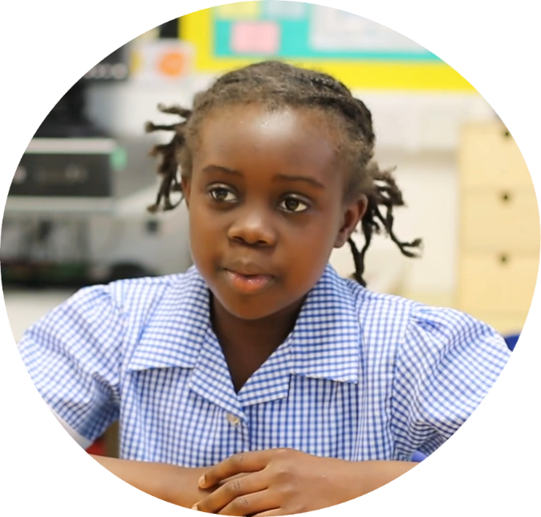
What should you do now?
Listen fully, be supportive, take them seriously
Let them lead the conversation
Reassure them it’s not their fault
Ask open questions, not closed or leading questions
Reflect back what they’re saying
Be honest that you can’t keep it confidential. Be clear about what you’ll do next
Don’t try to investigate it yourself
© The Key Support Services Limited
Notes:
Ask staff: if they’d heard this disclosure, what should they do now?
Click to bring up the points on screen and briefly talk through them
Listen fully, be supportive and take Jenny seriously. Use your body language to show you’re listening
Let Jenny lead the conversation
Reassure her it’s not her fault – children will often blame themselves for abuse
Ask open questions, to let her lead the conversation. Don’t ask closed or leading questions – remember, the record of the disclosure could be used in court, so leading questions could make it less credible
Reflect back what Jenny’s saying: this will help show you’re listening, and helps make sure you understand what she’s saying
Be honest that you can’t keep it confidential. Be clear about what you’ll do next: you won’t be able to keep a promise to keep it secret, so it’s better to be upfront than risk losing Jenny’s trust
Don’t try to investigate it yourself: similarly, don’t try to confront any alleged abuser. It’s the DSL’s job to co-ordinate the response to a disclosure
Emphasise that it’s important to respond in a way that shows the child they can trust adults and that you’ll help them. A child won’t necessarily make a full disclosure in their first disclosure. By responding in the right way, we can help them to make further disclosures in the future
Sources:
NSPCC, Let children know you’re listening. https://learning.nspcc.org.uk/research-resources/2019/let-children-know-you-re-listening
NSPCC, No one noticed, no one heard. https://learning.nspcc.org.uk/research-resources/2013/no-one-noticed-no-one-heard
NSPCC, What to do if a child reveals abuse. https://www.nspcc.org.uk/keeping-children-safe/reporting-abuse/what-to-do-child-reveals-abuse/

Slide 10
PREVENT DUTY
Spotting the signs of radicalisation
Radicalisation can be really difficult to spot. Signs include:
  isolating themselves from family and friends
  talking as if from a scripted speech
  unwillingness or inability to discuss their views
  a sudden disrespectful attitude towards others
  increased levels of anger
  increased secretiveness, especially around internet use.
Children who are at risk of radicalisation may have low self-esteem, or be victims of bullying or discrimination. Extremists might target them and tell them they can be part of something special, later brainwashing them into cutting themselves off from their friends and family.
However, these signs don't necessarily mean a child is being radicalised – it may be normal teenage behaviour or a sign that something else is wrong.
Pass any concerns to the safeguarding team

Slide 11
Safeguard Yourself
Just as we safeguard the students in our care, we need to ensure we safeguard ourselves
That means not putting yourself in a vulnerable position with students
  Always meet students with another member of staff present
  Never give out personal details to students
  Remain professional (this can still be warm and friendly!)

Slide 12
Safeguard Yourself
As carers of young people, we come across some disturbing or upsetting situations
It is vital you reach out to a colleague to de-brief and to discuss how you feel in relation to the case
This will mean unpicking how and why you acted as you did, as well as how and why you feel as you do
You may then be offered further professional support if circumstances dictate
You must also ALWAYS ensure you sign in and out, so that we have a record of who is on-site in case of emergencies

Slide 13
Acronyms…
FGM = Female Genital Mutilation
CP = Child Protection
RSE = relationships and sex education
DSL = Designated safeguarding lead
SCR = Serious Case Review
LADO = Local authority designated officer

Slide 14
Remember… pass on any concerns, no matter how small
All information helps to build a pattern of each student in our care
safeguarding@reading-school.co.uk

Slide 15
A Day in the Life of a Reading School Student…
“Today I woke up late, as there had been lots of arguments at home last night. I had to get my little sister ready for school and drop her off at the bus stop before getting to school myself.
I arrived late, forgot to sign in, and had to walk into the lesson hungry and tired. My teacher told me to sign in with student services, so I had to leave again and got a lecture from them about being late.
In the lesson I got a behaviour point for having my head on the desk, as I was so tired.
At lunch, I had to do the homework that I forgot, so I didn’t eat or see my friends.
I don’t have anyone to talk to about this, I don’t want anyone to know. The only release I have is the club that I attend, but my nerves are so fragile from all the shouting at home that I don’t even want to do that.”
How might this student be feeling?
What might the student need from different people at school?
How could you provide a safe space for this student in your role?
What specific things do you do or say to the students you see, to make them feel safe and secure? How do you build those positive relationships?
There are lots of students with similar circumstances at Reading School. It is important to remember this, and that our job is to nurture and provide support in a variety of ways.

Slide 16
Please complete this form to show you have understood your training
Safeguarding Training Form

Slide 17
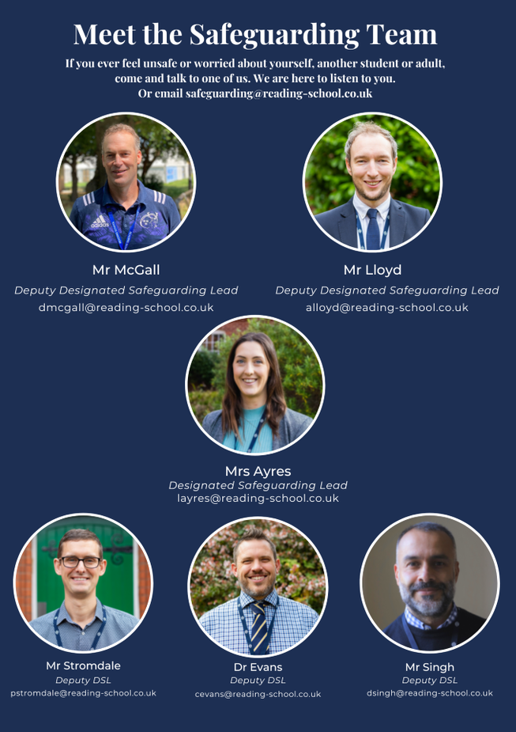
Reading School
Safeguarding and Child Protection
safeguarding@reading-school.co.uk

